Slide 1



Slide 2




TEACHERS, PLEASE SHARE PHOTOS AND QUOTES ON SOCIAL MEDIA:
#WalkToSchool
LivingStreetsUK LivingStreets

Slide 3
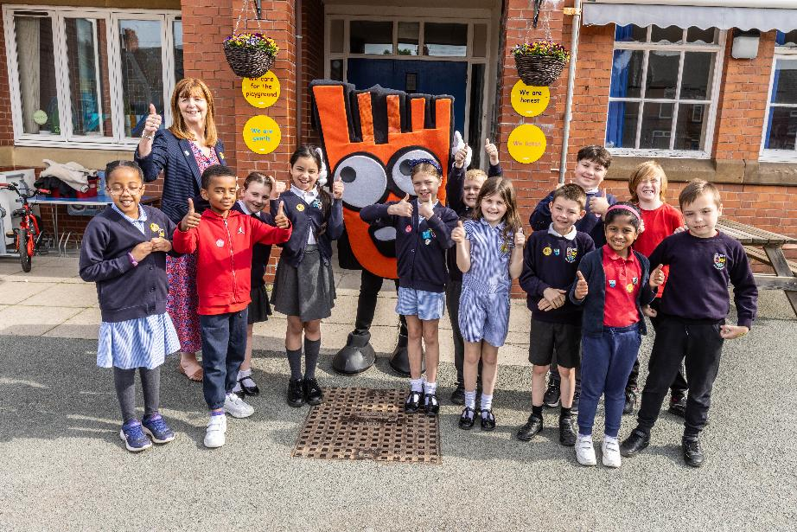
WOW ACROSS THE UK
APRIL 2025 – MARCH 2026
22 MILLION
New walking journeys
2,287
WOW schools
738,280
Pupils logging

Slide 4
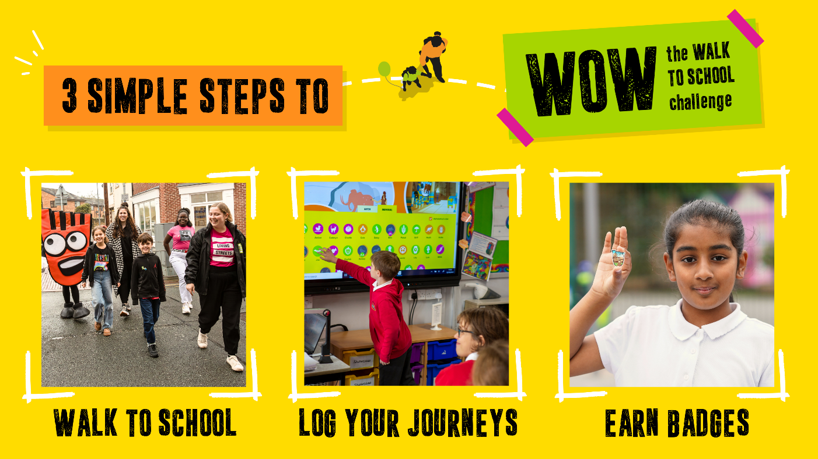
HOW DOES WOW WORK?

Slide 5
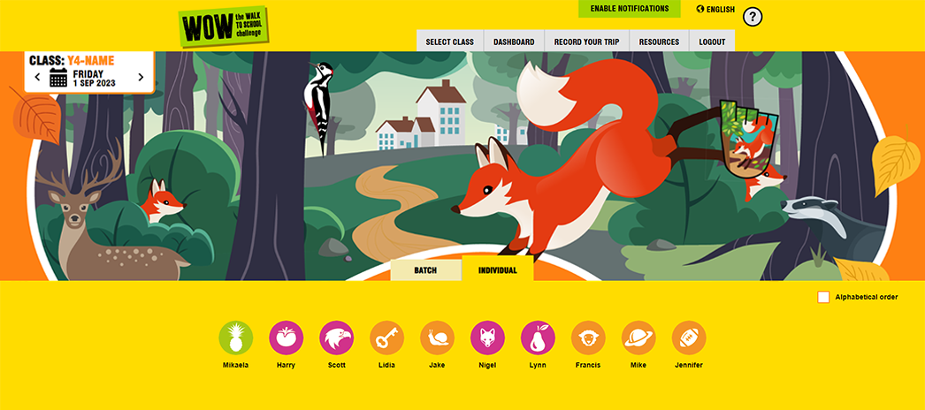
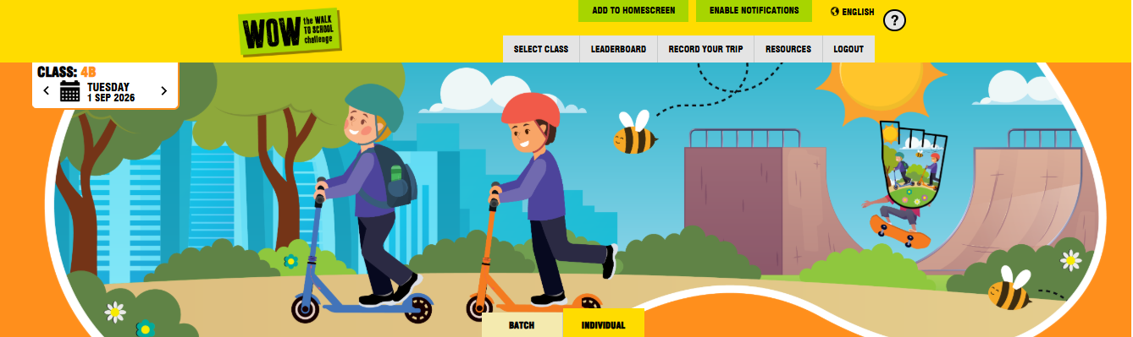



WOW TRAVEL TRACKER

Slide 6
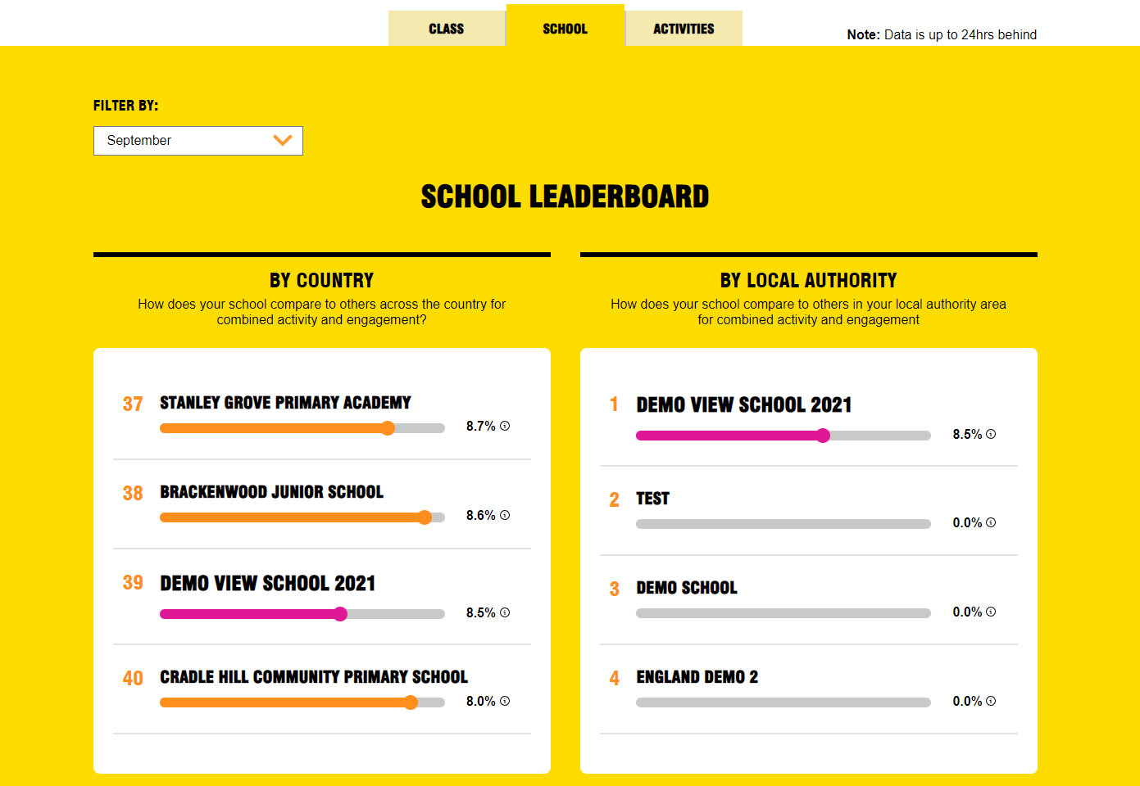
WOW TRAVEL TRACKER
LEADERBOARD

Slide 7

QUIZ TIME!
TRUE OR FALSE

Slide 8


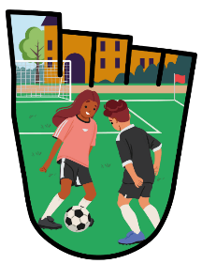
Active travel is when we use the car to make a journey…
TRUE OR FALSE?

Slide 9
FALSE
WE USE OUR BODIES!
WALK, WHEEL, CYCLE, SCOOT

Slide 10




Walking is good for our bodies, minds and the planet…
TRUE OR FALSE?

Slide 11
TRUE
200 MUSCLES ARE USED WHEN WALKING!

Slide 12


Road transport is the biggest source of air pollution in the UK…
TRUE OR FALSE?

Slide 13
TRUE
MORE CARS MEAN MORE POLLUTION

Slide 14

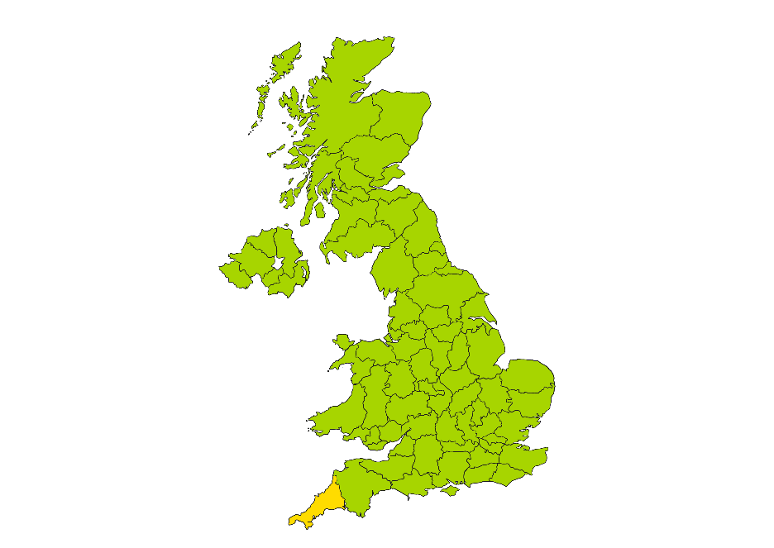








OUR PLANET MATTERS
COMMITTED TO REDUCE WASTE
CORNWALL
RECYCLED AND REUSED MILLIONS OF BADGES

Slide 15
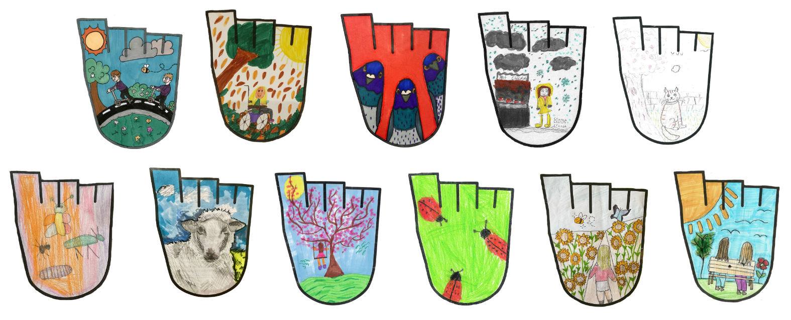
WOW DESIGN COMPETITION
OUR WINNERS!

Slide 16
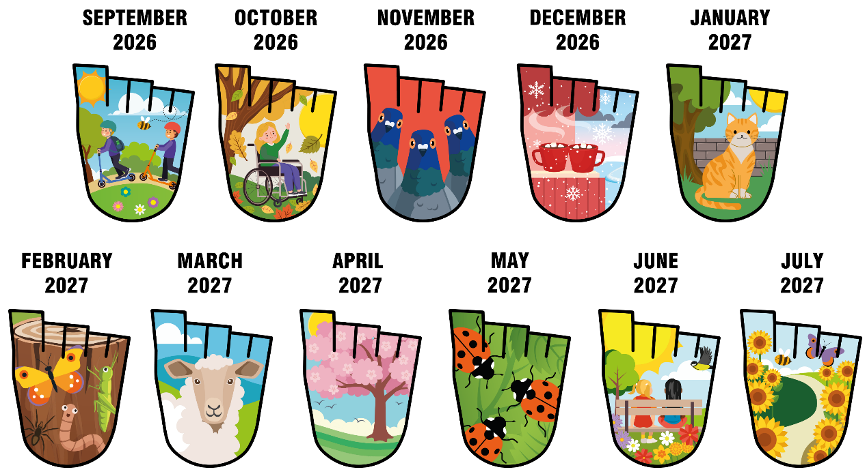
WHICH IS YOUR FAVOURITE?
WALK THE SENSES 2026-27 WOW BADGES

Slide 17

WHAT’S COMING UP?

Slide 18

WOW TOP TEN

Slide 19


WOW AMBASSADORS

Slide 20
TEACHERS, PLEASE SHARE PHOTOS AND QUOTES ON SOCIAL MEDIA:
#WalkToSchool
LivingStreetsUK LivingStreets

Slide 21
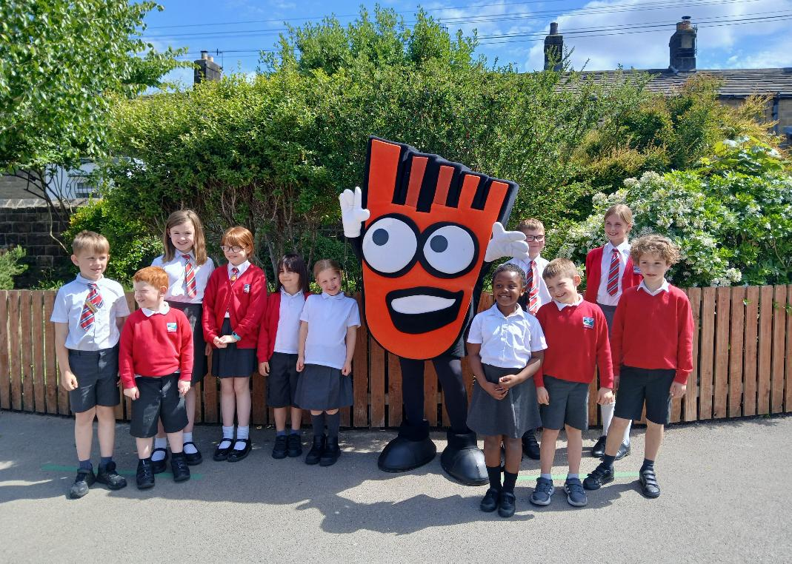
LET’S GET WALKING WITH WOW!

