Slide 1
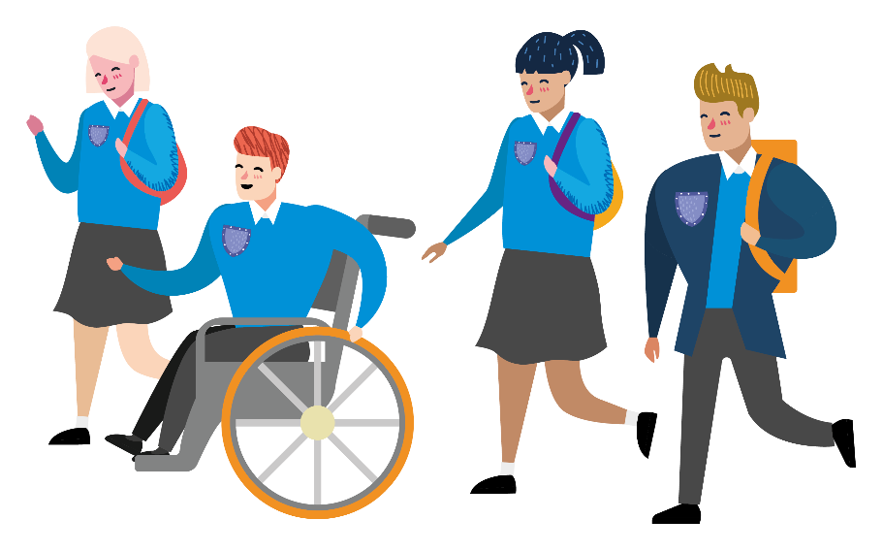
Notes:
This presentation is designed to support your Next Steps to Secondary School KS3 Walking Challenge resources.
Use it to facilitate a short session when launching the challenge, either in the classroom or an assembly.
It will help your students to consider the reasons to be active on their journey to/from school and explain how they can take part in the challenge.
Before you start, make sure you have completed Survey One (found in classroom pack) to record baseline data, then hold onto it until the end of the challenge.

Slide 2
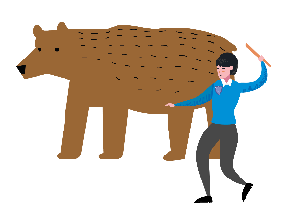
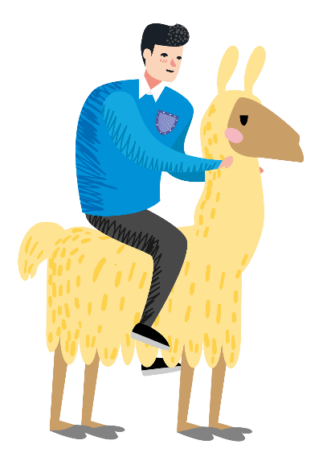
How did you travel to school today?
Notes:
We’re taking part in the Next Steps Walking Challenge!
We’ll consider how we currently travel to and from school, and how we could benefit from being more active.
Ask two or three volunteers how they travelled to school this morning and why.

Slide 3
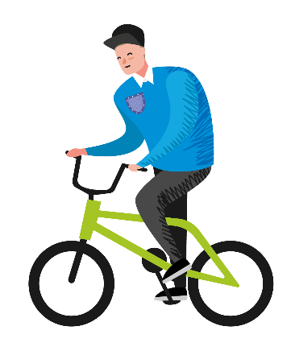
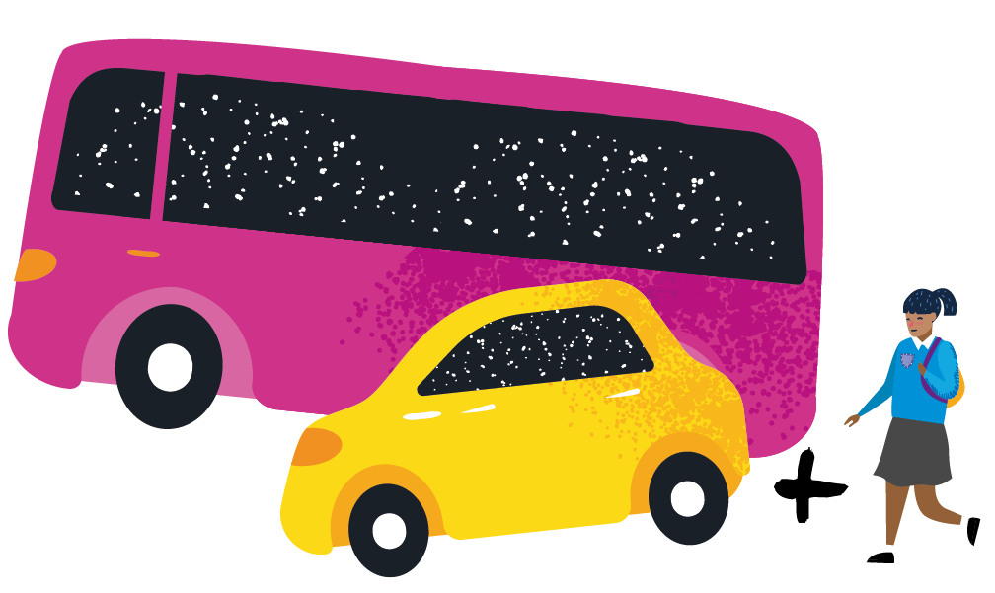
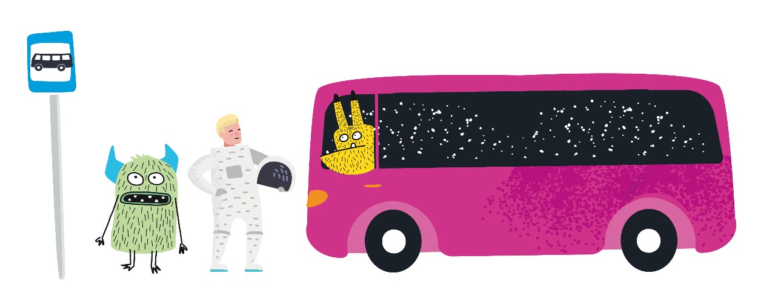
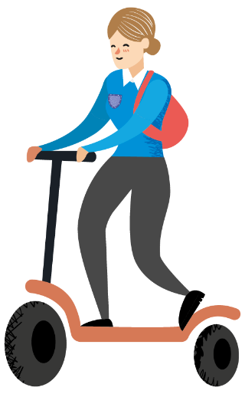
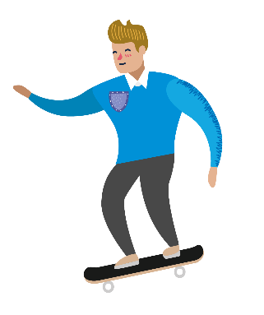
There are lots of ways to travel…
Notes:
There are lots of ways to travel, including:
Walk / wheel – walking or wheeling all the way to school
Includes those walking with mobility aids, such as wheelchairs or wheeled walkers.
Cycle / scoot / skate – riding to school on a bike, scooter or skateboard
Public transport – using buses and trains to get you to the school gate
Car / taxi – traveling directly to school by car
Walk part of the way – this combines public transport, car or taxi with a walk at the end to complete the journey. For example, getting out the car or off the bus a 10-minute walk from school, then walking / wheeling from there.

Slide 4
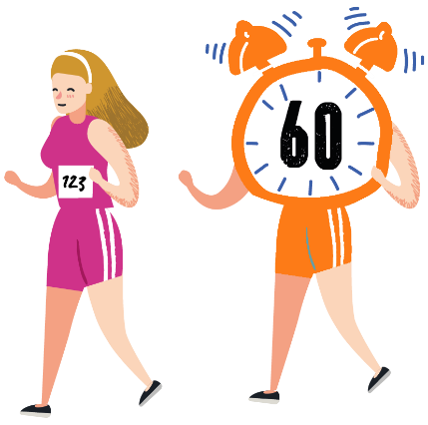
Reasons to move more
on your journey to school
Saves money
Helps you stay healthy
£££
Makes you feel happier
Doesn’t cause pollution
Time with friends
Gives you independence
Notes:
Some of you might need to use public transport or the car to travel to school but keeping active is really important. Here are some good reasons to include some physical activity, like walking, as part of your journey.
Ask the class whether they can think of some good reasons to be active on their journey, then click to reveal the answers on screen.

Slide 5
Next Steps Walking Challenge
HOW MANY
x
CHALLENGES
CAN YOU
COMPLETE?
Notes:
The Next Steps Walking Challenge is designed to help you benefit from moving more on your journey to and from school.
You’ll each receive a card with a set of challenges – some will help you prepare to walk more. Others will encourage you to get out and move!
The aim is to complete as many of the challenges as you can, ticking them off as you go.

Slide 6
How to enter
NAME
I HAVE
COMPLETED
NEXT STEPS
CHALLENGES
_ _ _
TUTOR GROUP
TEAR HERE
Notes:
The challenge period will close on <insert date>.
To enter, you’ll simply need to complete and return the bottom section of your challenge card, confirming your name, tutor group, and the number of challenges you have completed.

Slide 7
A chance to WIN!
Notes:
Those that complete the challenge and return their card will be entered into a prize draw!
One lucky student from each class will win a £10 Love2Shop voucher, which can be used in a range of different shops.
Finish by handing out the challenge cards and answering any questions.

