Slide 1

Notes:
Holding slide whilst children are entering assembly hall.

Slide 2



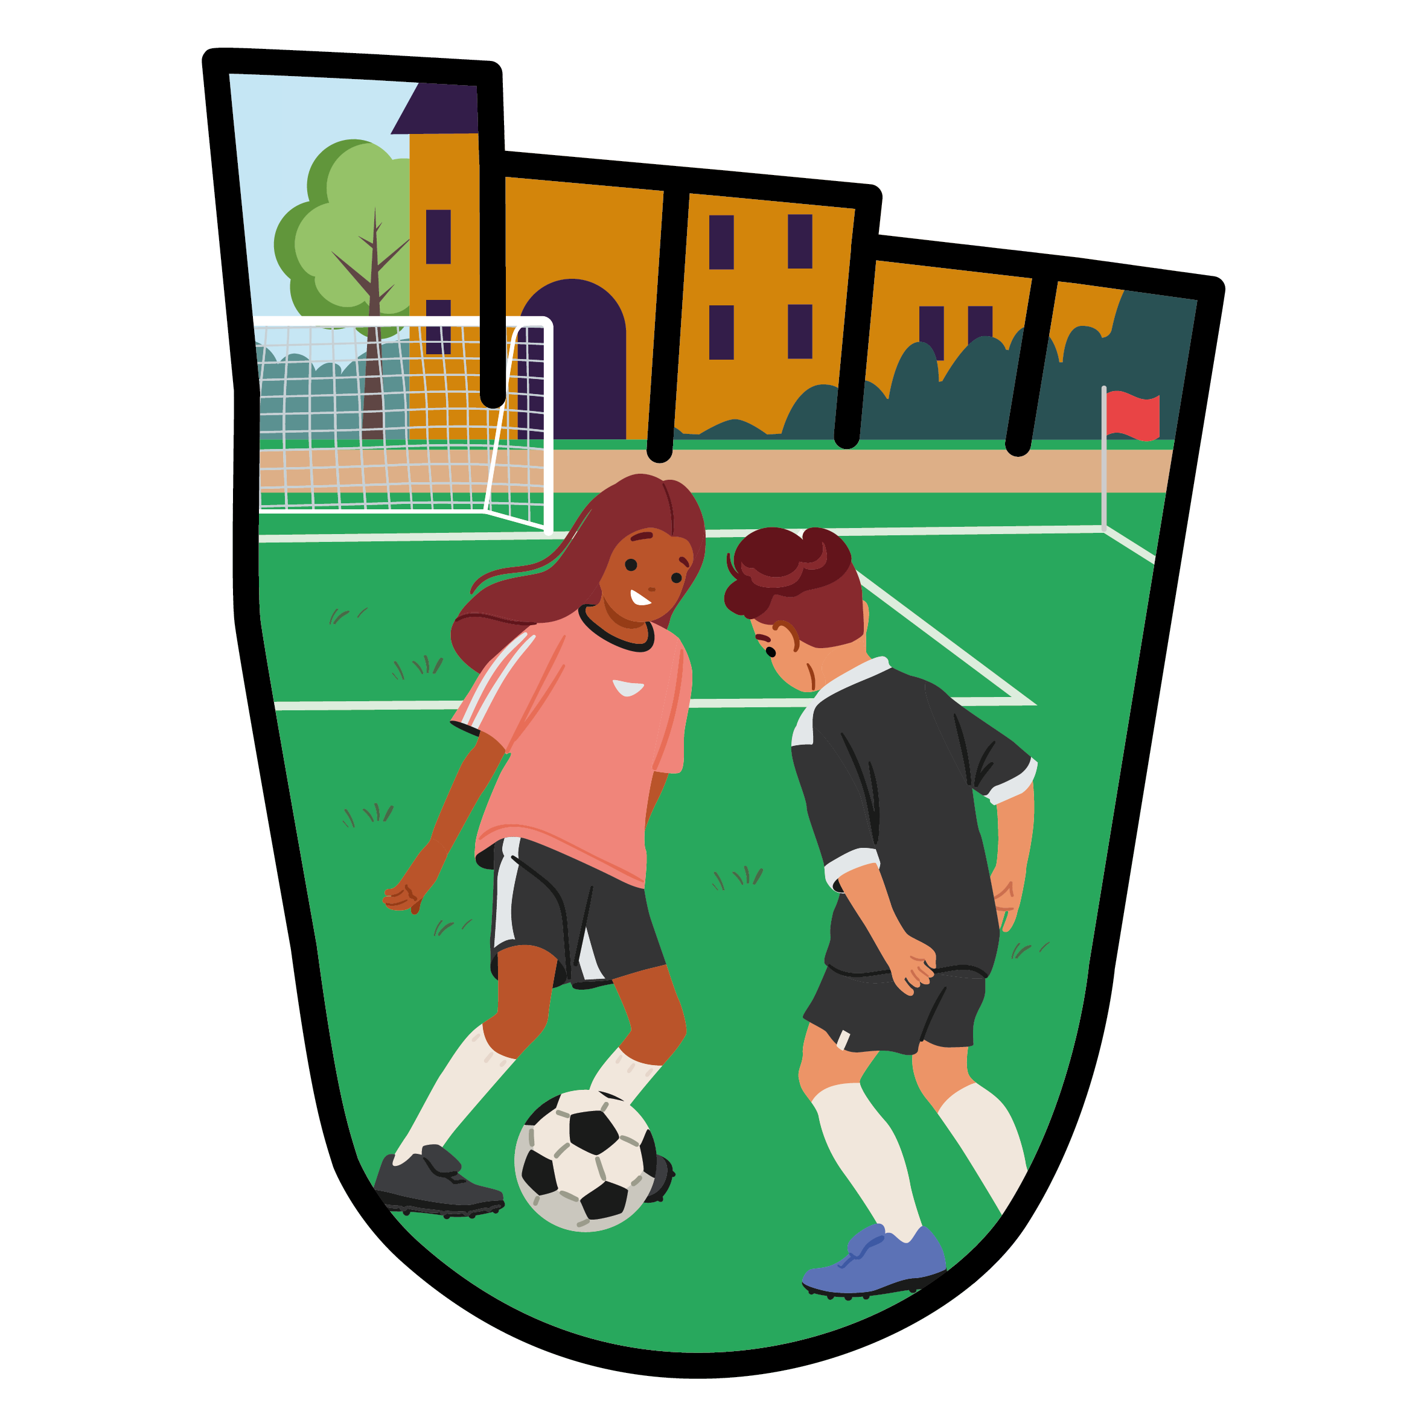
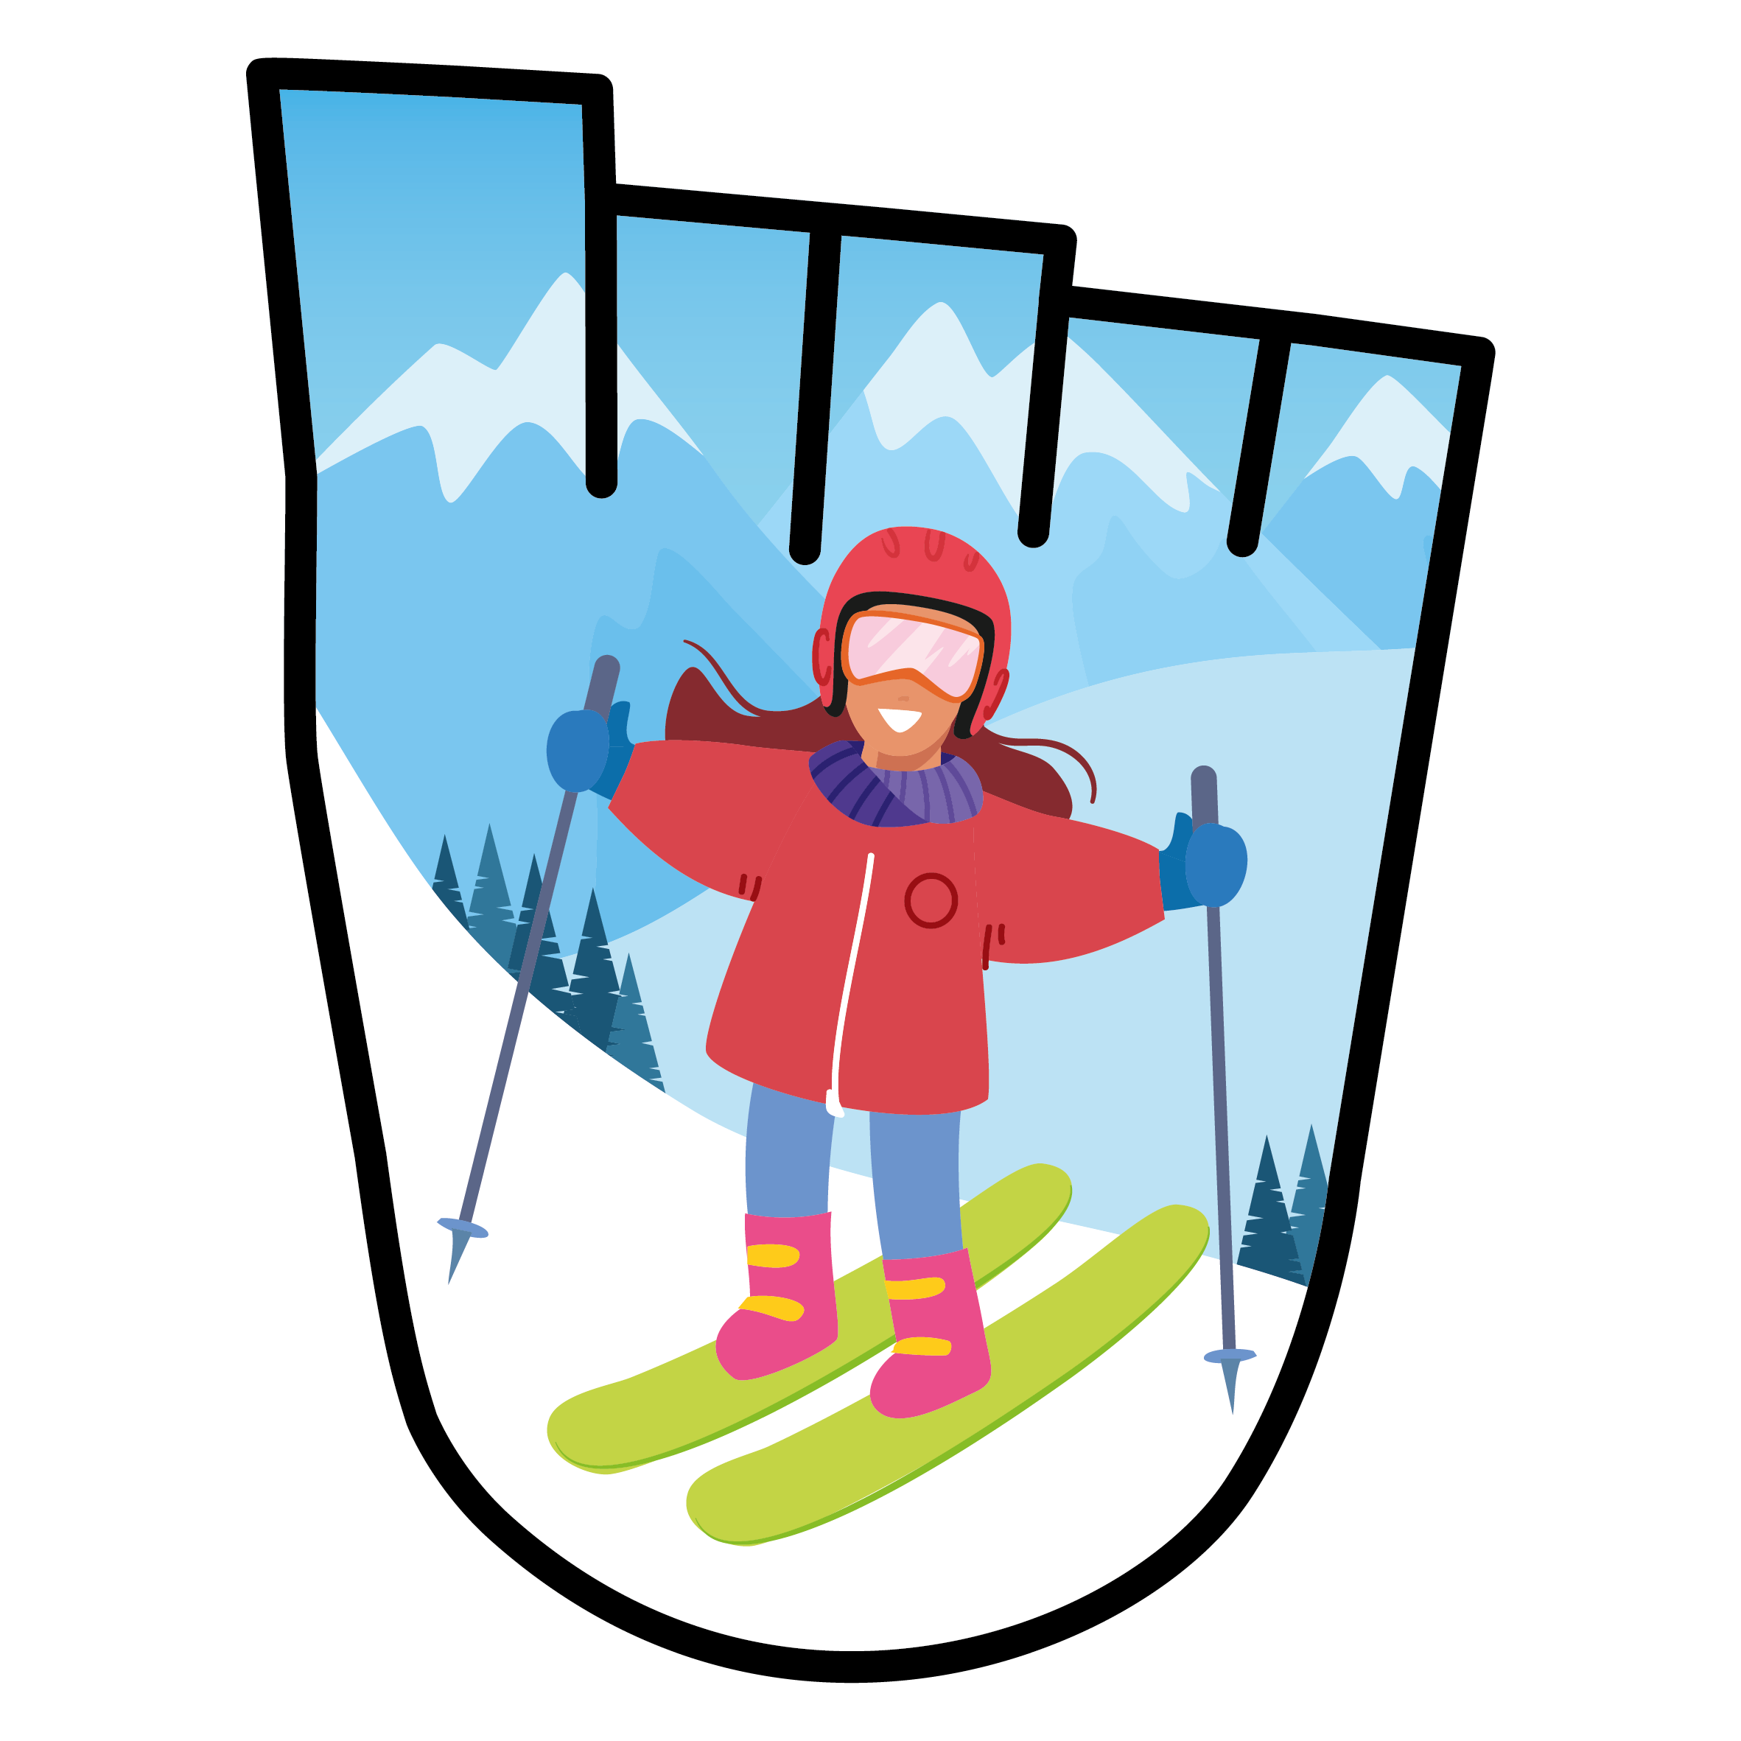



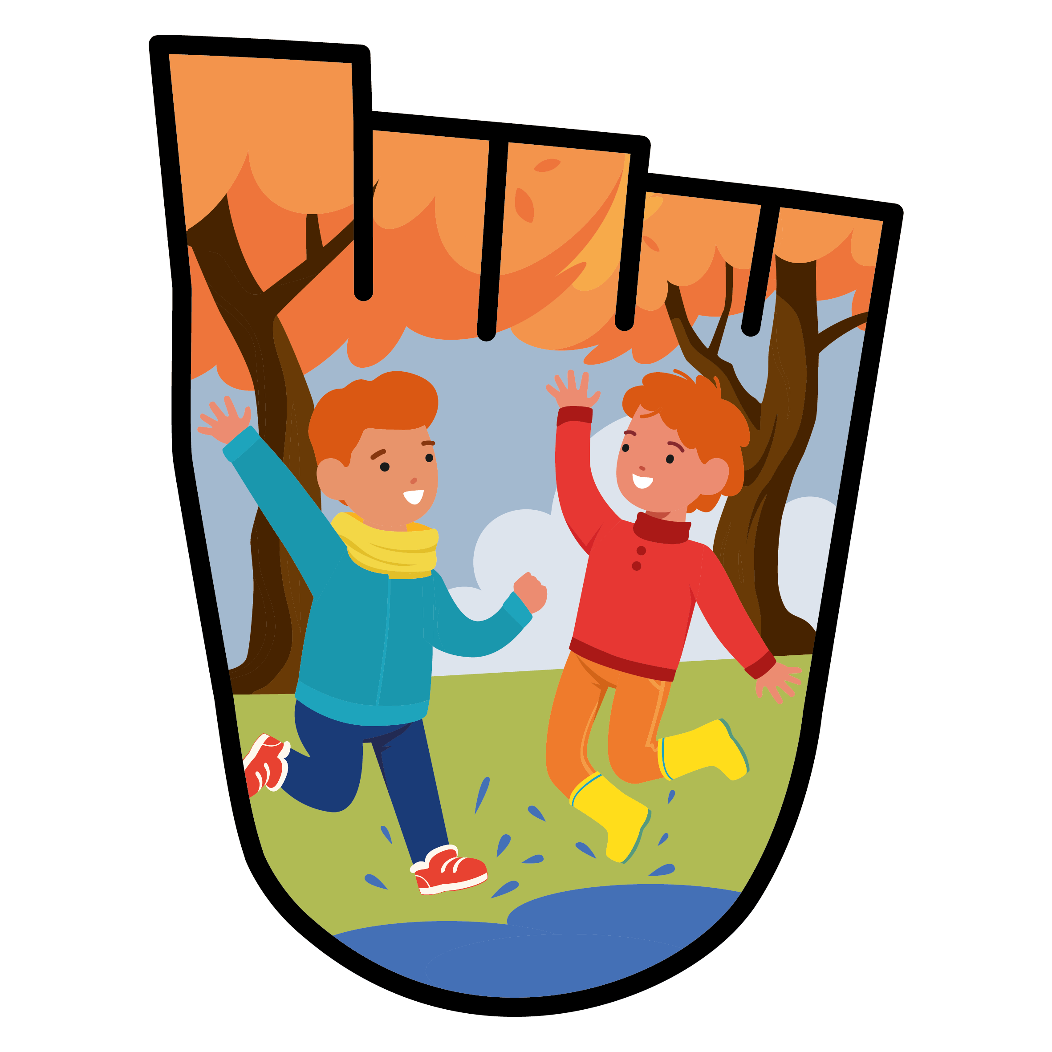

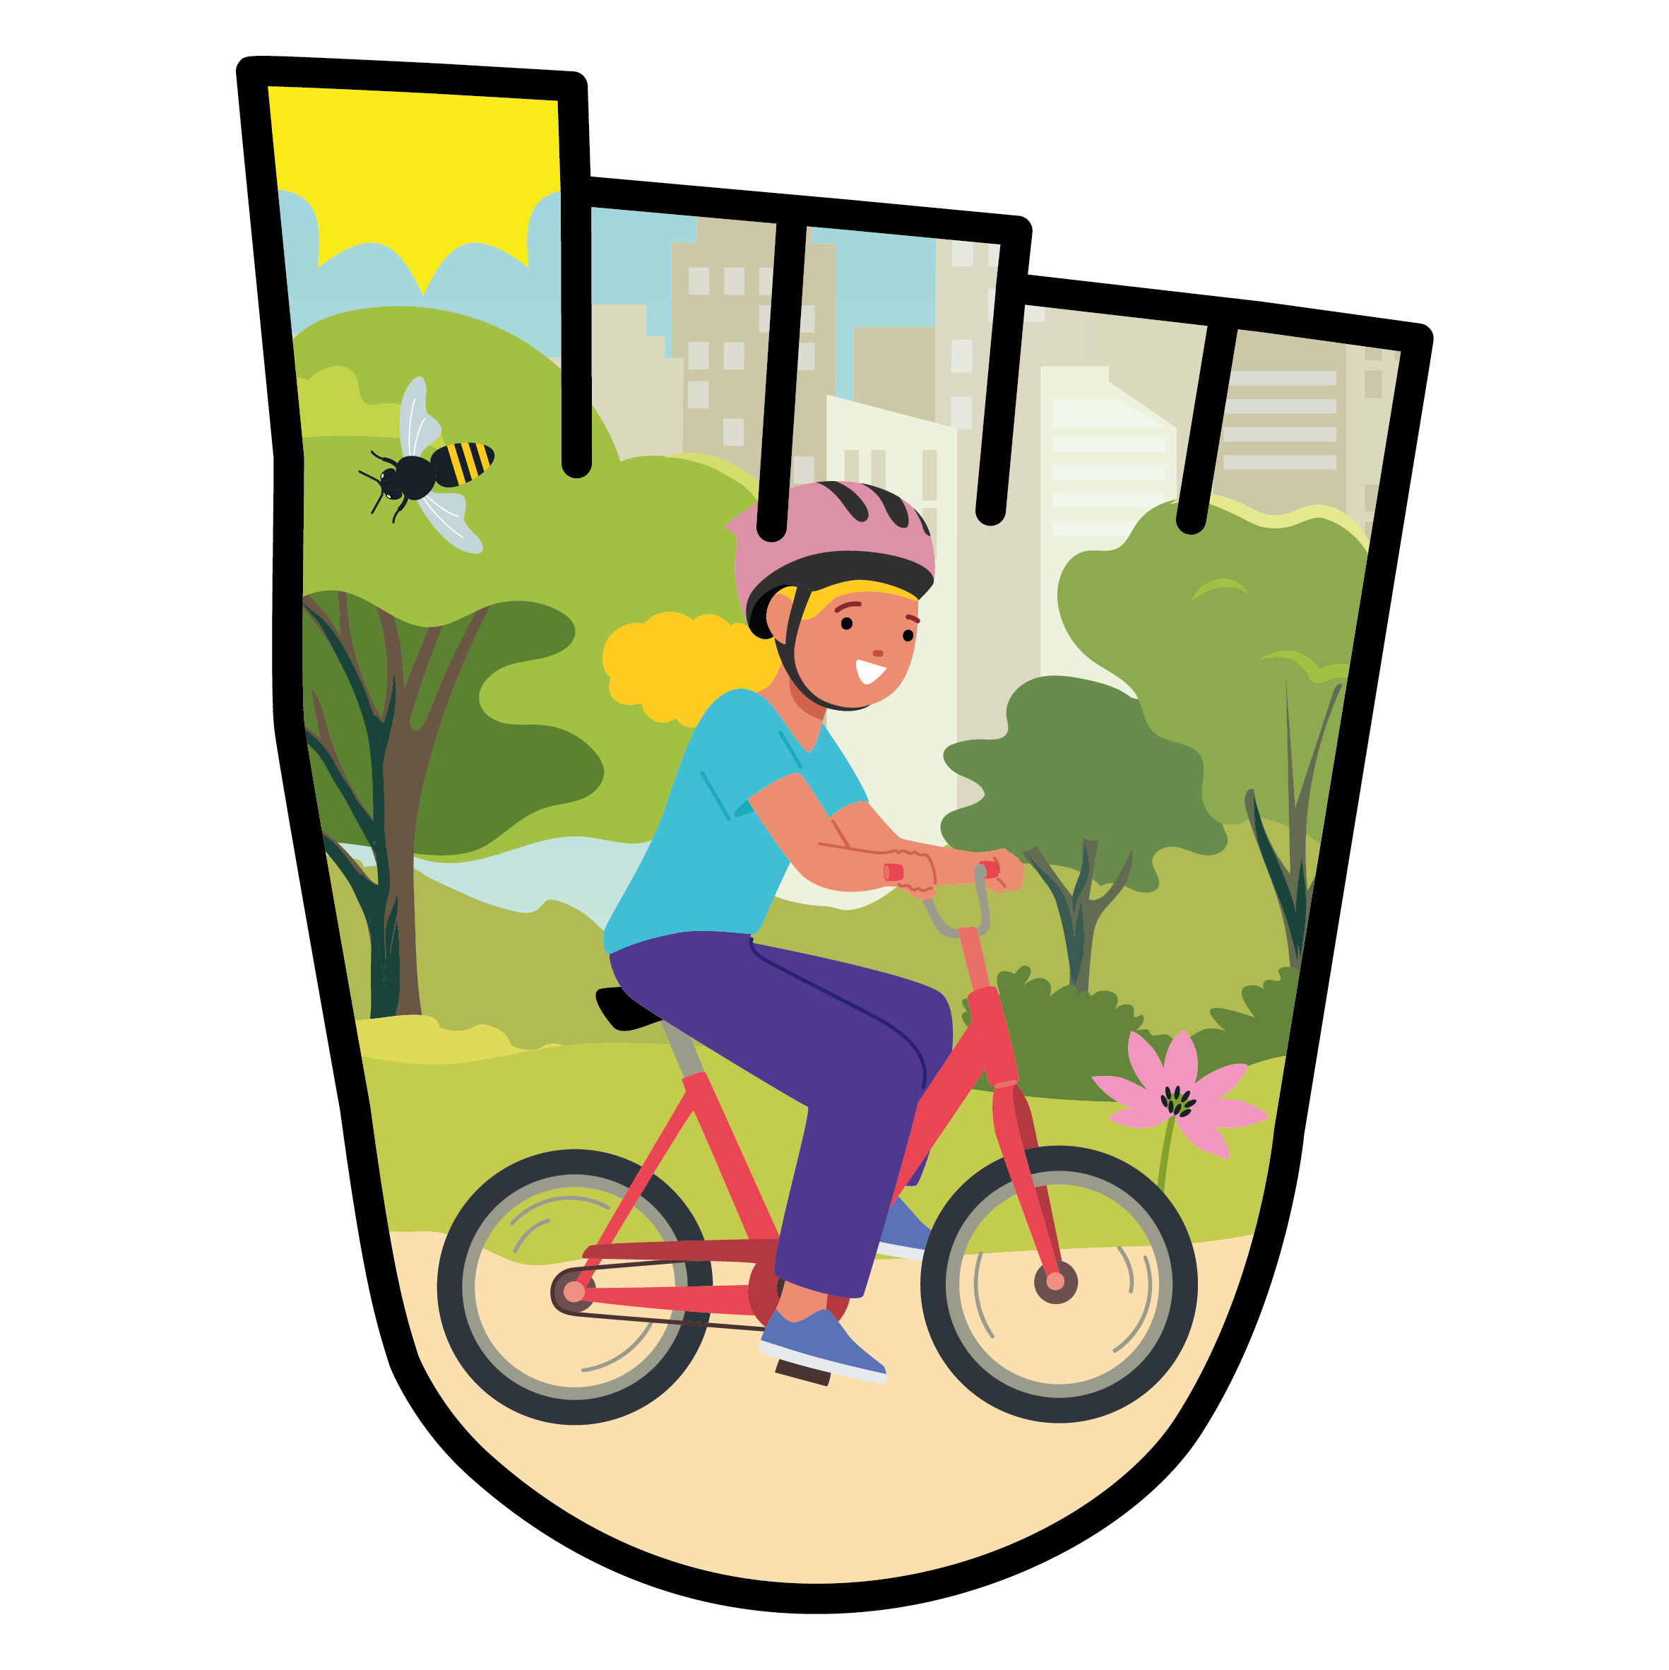

WELCOME TO WOW!
Hello, we're Living Streets, the UK charity for everyday walking
I hope you enjoy this presentation and I look forward to seeing how many of you are walking or travelling actively to school.
Notes:
Hello everyone, I’m xxxx from Living Streets, the UK Charity for everyday walking. I’m here to talk about walking to school and the reason for that is, starting tomorrow/next week, your school is taking part in WOW, the Walk To School challenge. The great thing about WOW is that it doesn’t just last for a week, or a month, but will run for the whole of this school year! The even better news is that you can earn special badges, just like these on the screen, for walking or wheeling/travelling actively to school. Put your hands up if you’re up for a challenge! Great, put them down. Before I tell you how the challenge works, I want you to have a think for a few seconds about how you travelled to school today. How did you get to the school gate?

Slide 3

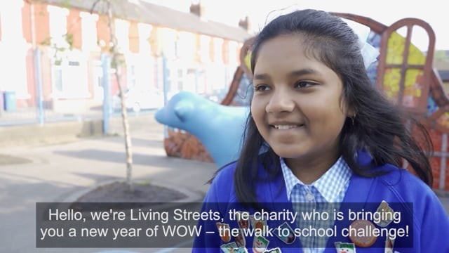

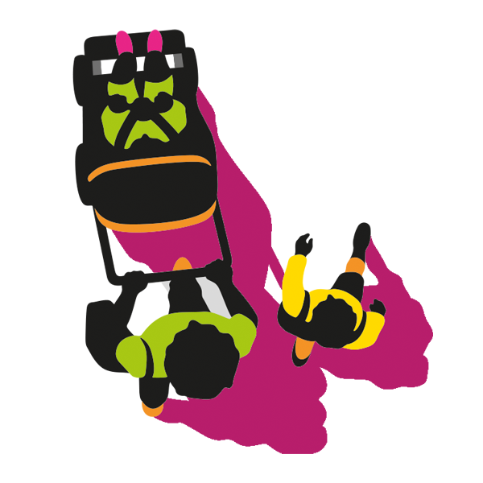
WATCH THE VIDEO
Notes:
**Optional video slide – video is 2 mins 30 secs long
NEW VIDEO TO BE ADDED 30 AUGUST 2025

Slide 4

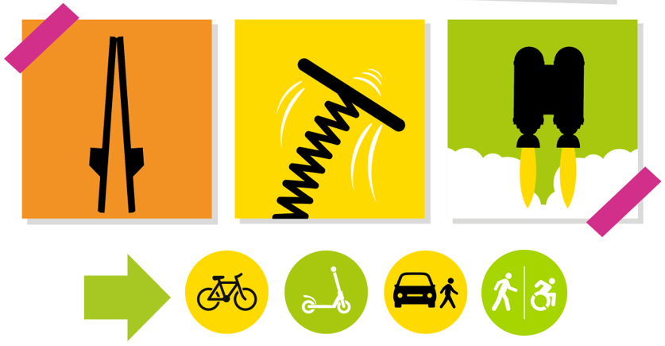
HOW DID YOU GET TO SCHOOL TODAY?
Notes:
Who came on a pair of stilts?! Who came with a jet pack strapped to their back and flew over the school gate like a rocket?! (“There’s always one or two, it’s always the older lads at the back!” – “Maybe you did, who knows?”) OK, hands up if you came by car and got dropped off somewhere near the school gate this morning? That’s fine. (Then ask ‘Who came on a bike/scooter/bus?’ in turn.) Is that everyone? Have I forgot anything? (wait for someone to say walking). Ah, of course, I nearly forgot (!!), put your hands up if you walked or wheeled all the way to school?
That’s great.
WOW is all about encouraging more of us to walk or wheel to school, and, more often. It’s good to walk or wheel for so many reasons.
For the rest of this presentation, when we talk about ‘walking’ we mean ‘walking and wheeling’ to school.

Slide 5
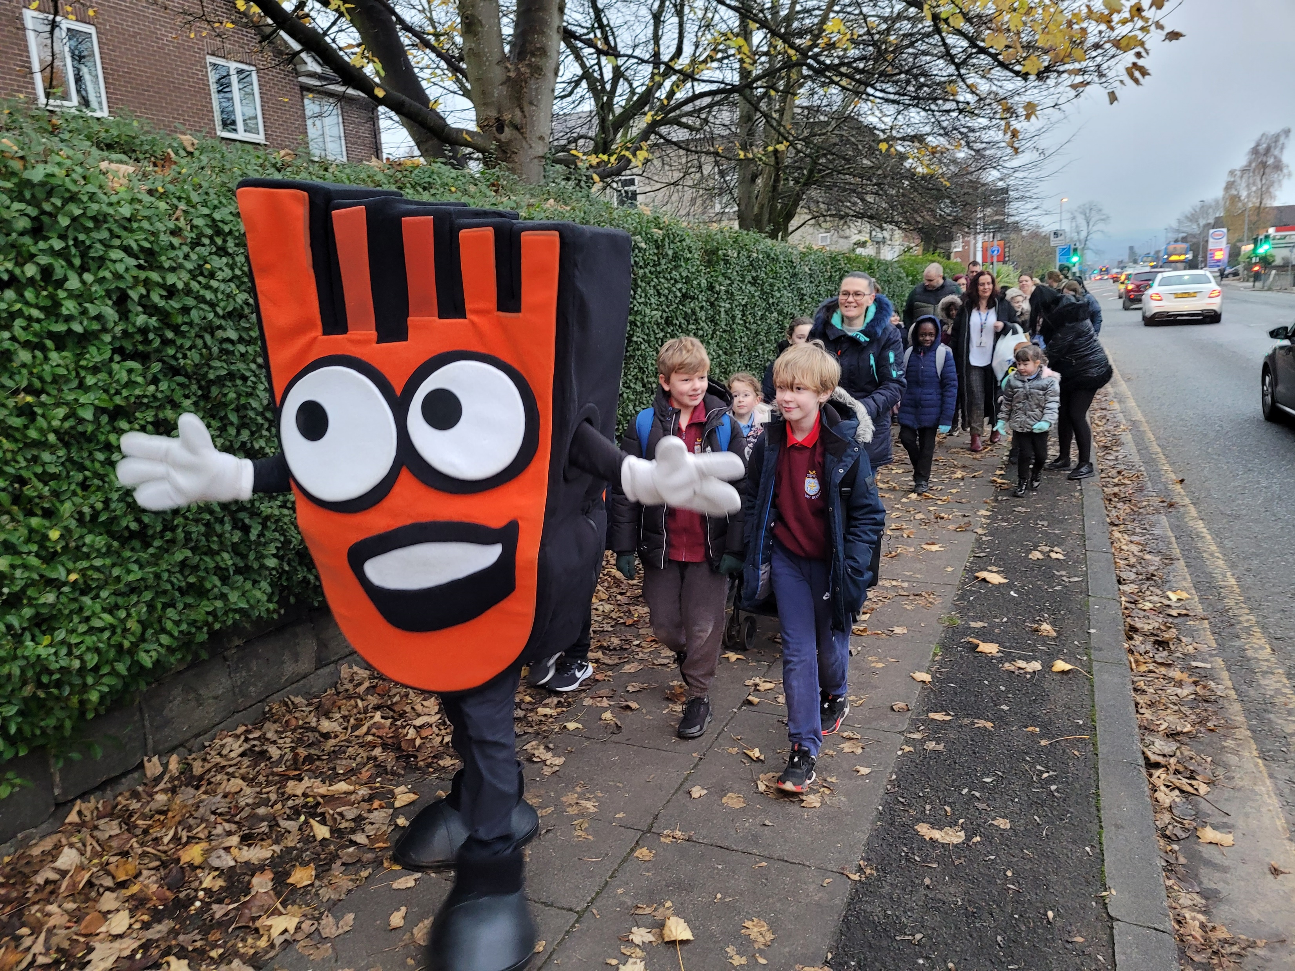
WHY IS IT GOOD TO WALK OR WHEEL TO SCHOOL?
Notes:
Since you’re all experts in travelling actively to school, who can tell me what the benefits (‘good things’ for KS1) are about walking or wheeling to school? Why is it good to walk or wheel to school? Hands up if you can think of reasons. [Take some answers – taking one or two answers from the younger children at the front and working your way back to get a range of answers.] That’s brilliant. You’ve come up with some great suggestions. Here’s some reasons I thought of – let’s see if we got the same things.

Slide 6

REASONS TO WALK OR WHEEL TO SCHOOL
HEALTHIER BODIES HAPPIER MINDS
Notes:
Walking is good exercise for us. As we walk our hearts beat faster, our breathing gets quicker, we warm up, and we feel energised. Exercise is important because it helps to keep our bodies healthy and is good for our hearts, lungs, muscles and bones.
Did you know that it’s recommended that you do around 60 minutes of physical activity every day?
Well, the walk to school is a really good way of getting some of that exercise in. Not only does walking help keep us fit and healthy, it can help wake us up in the morning and make us feel happy! If you walk to school, then you’ll be more alert and ready to learn when you come into the classroom. It will also help you concentrate better in class – and that’s really important for the school.

Slide 7

REASONS TO WALK OR WHEEL TO SCHOOL
FEWER CARS AT THE SCHOOL GATES
Notes:
Imagine if everybody walked or wheeled to school, there would be fewer cars outside the school gates. This would make it easier to cross the roads and much safer for all families walking to school.

Slide 8

REASONS TO WALK OR WHEEL TO SCHOOL
LESS POLLUTION = CLEANER AIR
Notes:
Walking and wheeling is also the greenest form of transport so you can actually help the planet too, by walking.
There are over 10 million children travelling to school every morning in the UK and nearly half of children travelling to school make that journey in a car (that’s a lot of extra cars on the road each morning!).
Why is it better for the environment if we walk or wheel rather than travel by car?
Do you think it’s better for you too if there are fewer cars on the roads? Why?
Yes, it is better for you to walk – you breathe in less air pollution than if you’re sitting in a car!
If more people walked, there would be fewer people in their cars and less pollution would be pumped into the air.

Slide 9

REASONS TO WALK OR WHEEL TO SCHOOL
FUN TIME WITH FAMILY AND FRIENDS
Notes:
Walking and wheeling to school is lots of fun and is a great time to talk to your family and tell them all about your day. If you arrive by car, it’s not always a good time to talk, because your parents/carers have to focus on the road more so probably won’t be able to talk as much.
If you walk to school, you could meet up with your friends on your way to and from school too – and catch up on all the gossip! Hands up if you met your friends on the way into school this morning? Great! Hands down.

Slide 10
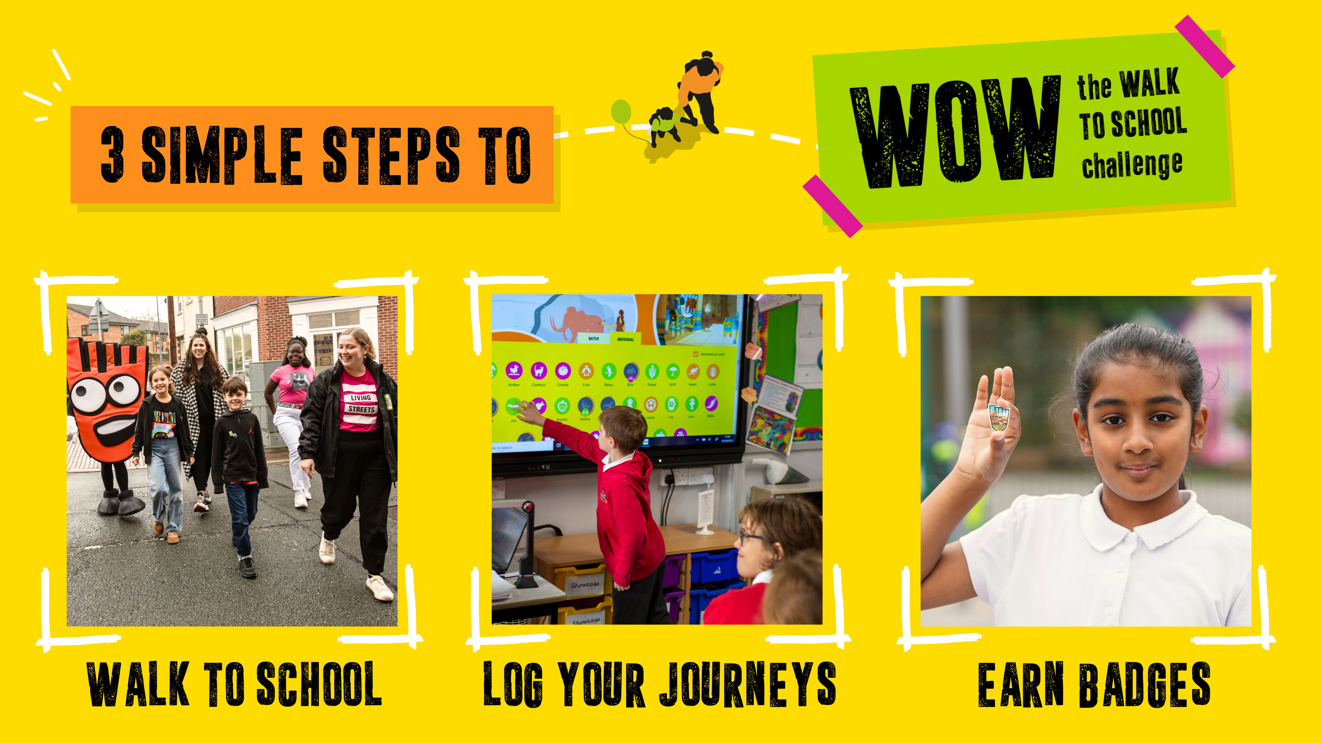
HOW DOES WOW WORK?
Notes:
So, let’s quickly look at how WOW works? Well, it’s really simple. You walk or wheel to school, you log your journey each day on the screen (which we’ll look at in a second), and you earn a different badge every month. It’s that easy.
​

Slide 11
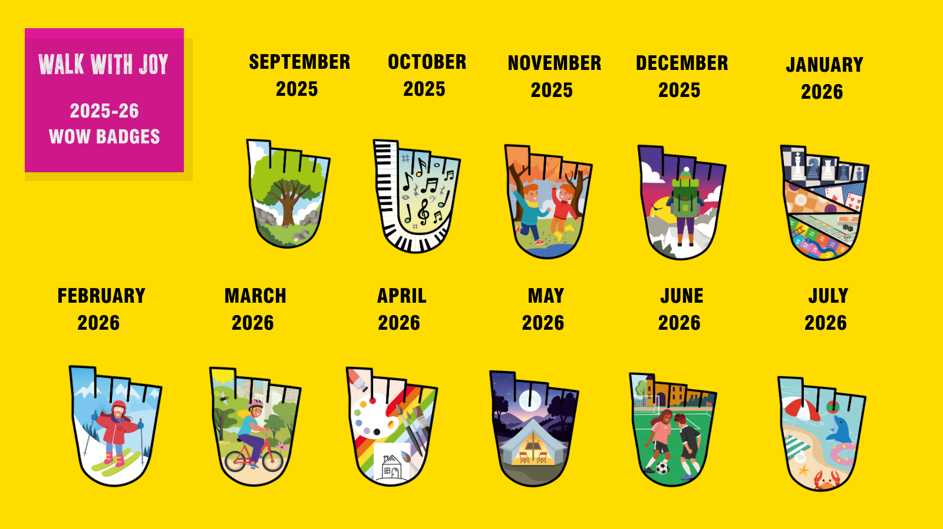
WHICH IS YOUR FAVOURITE?
Notes:
Speaking of badges - the moment you’ve been waiting for……these are badges you can earn this year! This year’s theme is Walk with Joy so we asked pupils to think about what makes them feel happy, from friends, to pets, silly games or things in nature. Each badge shows different things that might make you smile, whether that's jumping in puddles, biking to school or playing board games! All of the badges have been designed by children just like you. We have a big competition every year, and you guys can all have a go at designing a badge that tens of thousands of children might be wearing this time next year! Now, have a look and decide which is your favourite? (For KS2 you could mention here that they are made in this country [Cornwall] from recycled plastic plates/old fridge trays and yoghurt pot off-cuts)

Slide 12

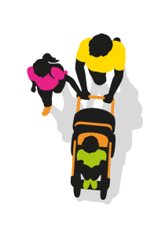
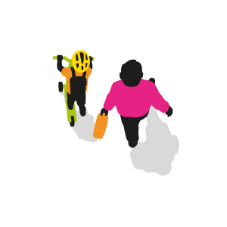
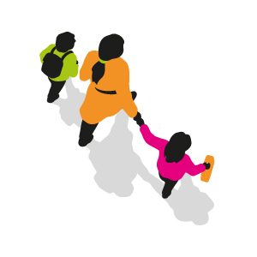
IT’S NOT JUST WALKING AND WHEELING
Notes:
It’s not just about walking and wheeling though. If you do walk/wheel all the way to school every day that’s great – you will earn a badge every month. If you can’t do this every day, but could do it at least once a week, you will still earn a badge at the end of the month. If you want to scoot or cycle to school that’s great too, as long as you do it at least once a week, you too will earn a badge.
But what about you children that have to come in a car? How can you earn a badge? Well, if you live too far away and can’t possibly walk all the way to school, you can do something called Park & Stride. To Park and Stride, you just need to park the car 10 minutes away from the school gates and walk the rest of the way. There may be a place close to your school which can be set up as a formal Park and Stride location.
If you can do this at least once a week, you will also earn a badge every month. We think that’s really fair. It means that everyone in this hall has the chance to earn a badge. Nobody has to miss out, and that’s really important.

Slide 13
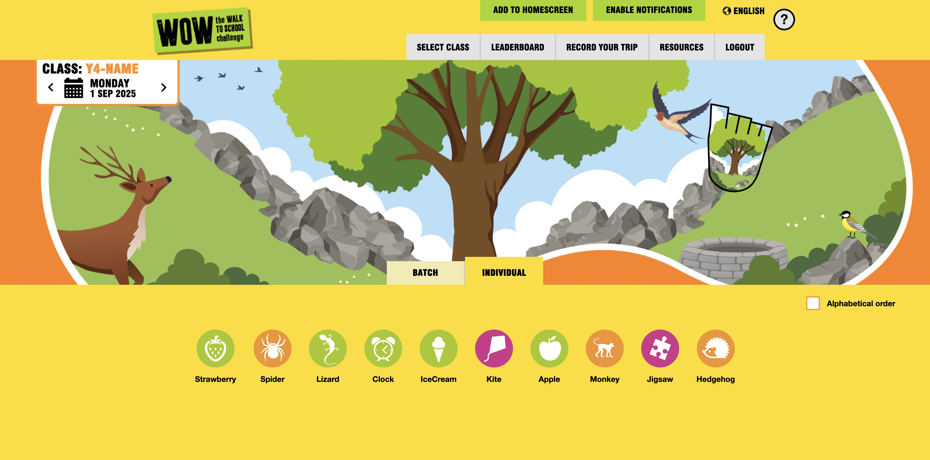



WOW TRAVEL TRACKER
Notes:
So… how will we know who has walked/ wheeled to school and who has cycled/scooted or come in a car? You are going to use something called the Travel Tracker. This is what your whiteboard screen might look like when the challenge starts. (Point out to teachers it works equally as well on tablets etc.).
There are few things to point out: Can you spot the badge on the right-hand side? This will tell you which badge to you trying to earn each month.
There is a calendar at the top left to show you are logging your journey for today. If you have missed a day, you can use this to go back and log the journeys you missed. We suggest you log your journeys daily as this makes it more accurate, and always check the calendar is set on the correct date before logging.
Below you can see lots of circles with white pictures inside. You will all have your own picture (and it might have you first name underneath, too!). All you have to do is find your picture and tap on it. This will take you to the next page.
TRAVEL TRACKER IMAGE TO BE UPDATED WHEN NEW IMAGE IS AVAILABLE

Slide 14
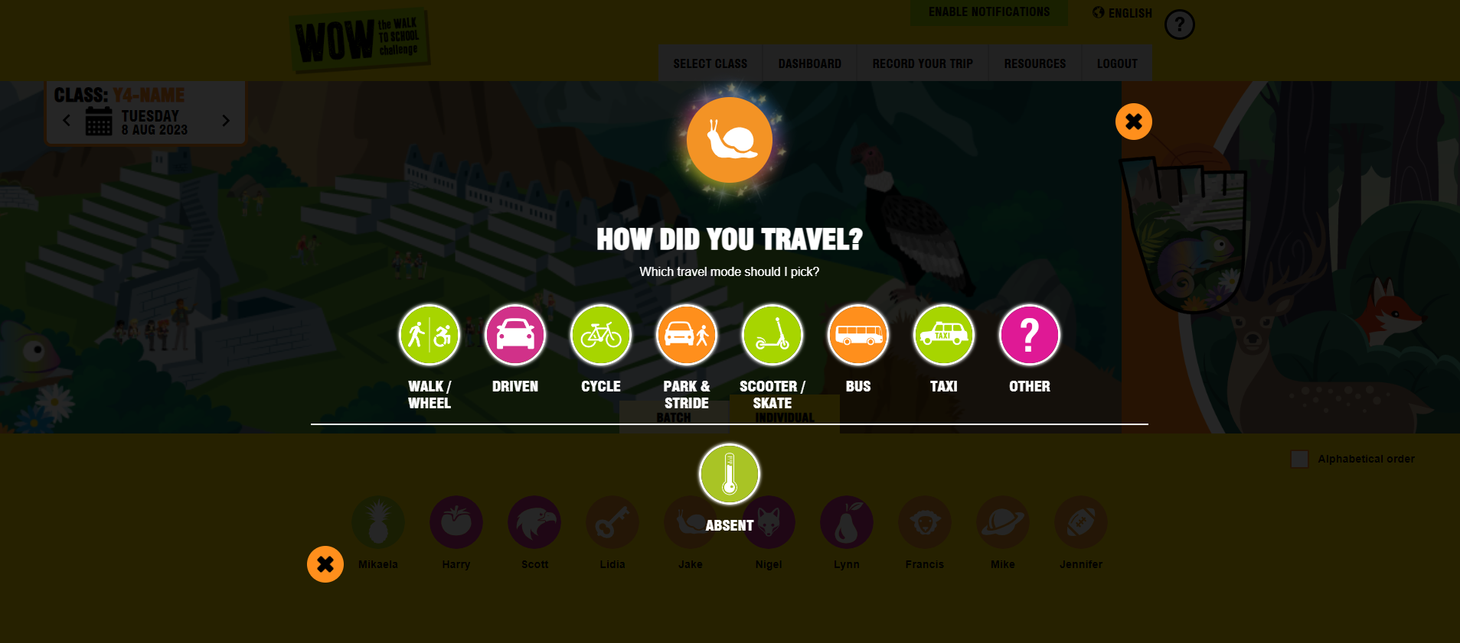
WOW TRAVEL TRACKER
Notes:
Travel Tracker will then ask you how you’ve travelled to school. Just select the picture that best matches how you’ve travelled to school that day. If you select the wrong picture by mistake, just click on the cross to go back.
Teachers - its really important that any absent children are marked absent using the green ‘thermometer’ button. This means it won’t spoil their chances of earning a badge at the end of the month – which is fair. Travel Tracker is really clever - at the end of the month it will show your teacher who has earned a badge by putting a little picture of the badge on the picture of each child who has earned one.

Slide 15
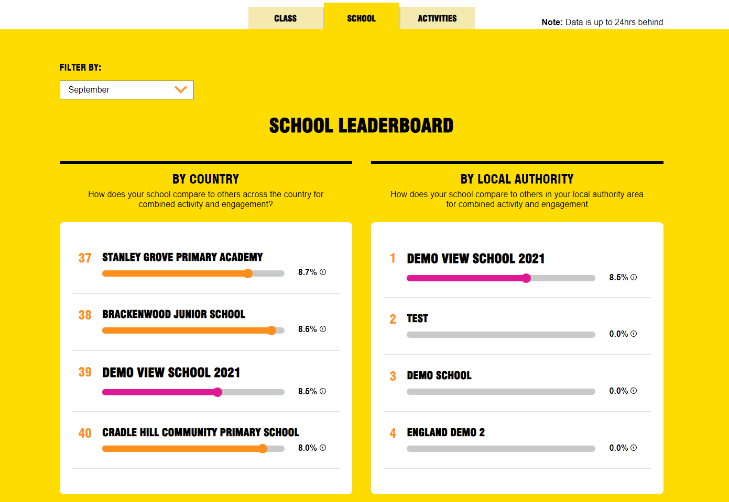
WOW TRAVEL TRACKER
LEADERBOARD
Notes:
Now, what Travel Tracker also has in it are some leaderboards. At any time, your teacher can look and see how your school is doing compared to all the other schools in your area (on the right), or, compared to all the other schools doing WOW across the country (on the left). The exciting news is that every term we have a special month-long challenge called the WOW Top Ten. At the end of the challenge, we look to see which schools have finished top of the leaderboards and give out certificates to the most engaged and active schools!

Slide 16

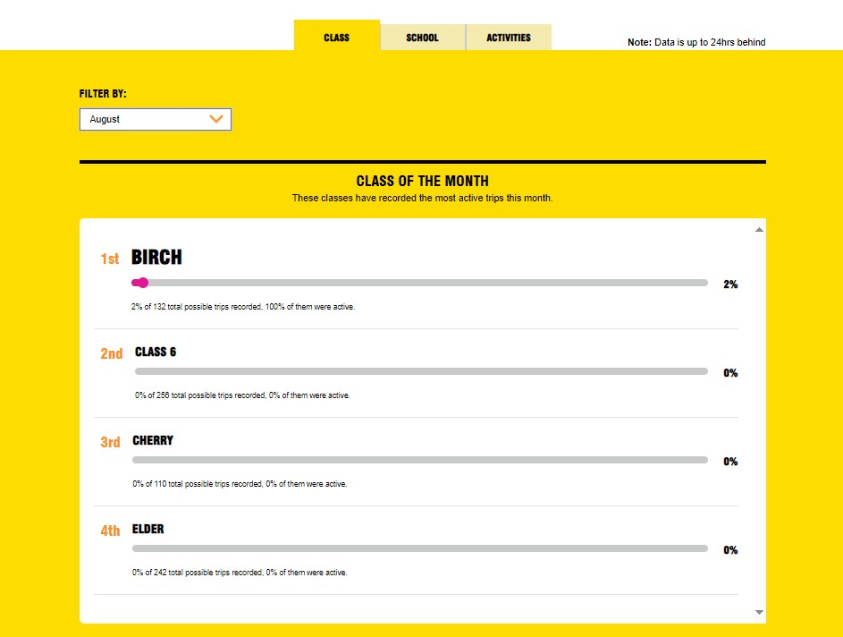



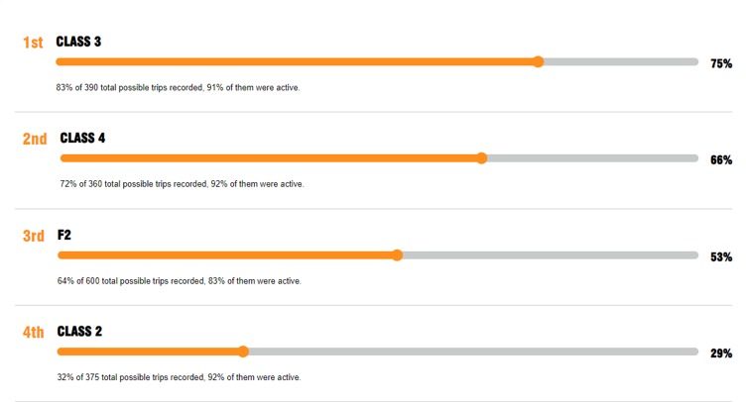
CLASS LEADERBOARD
Notes:
More importantly, perhaps, Travel Tracker has a class leaderboard where you can see how your class is doing compared to all the other classes in school. So, you need to encourage all your classmates to travel actively to school as much as possible so that your class can get to the top of the leaderboard. (To teachers/Head) Maybe the class that comes top of this leaderboard each month can receive a special trophy/prize that they can keep in their classroom for the whole of the next month? (We have a selection of editable certificates that your teacher can award to the top classes or to the whole school during assemblies!)

Slide 17
Notes:
(Slides 17-21 – extra slides if time allows) This year’s theme for the WOW challenge is ‘Walk with Joy’. Each of the badges, designed by children taking part in last year’s WOW badge design competition, shows some of the fun ways of travelling to school – like cycling or jumping in puddles!

Slide 18

HOW MIGHT YOU TRAVEL TO SCHOOL?
Notes:
Now, this is your chance to think imaginatively.
If you could get to school in any way you wanted to, how might you travel?
Use your imagination to think of some ways you could travel to school. Be as creative as you can be!

Slide 19

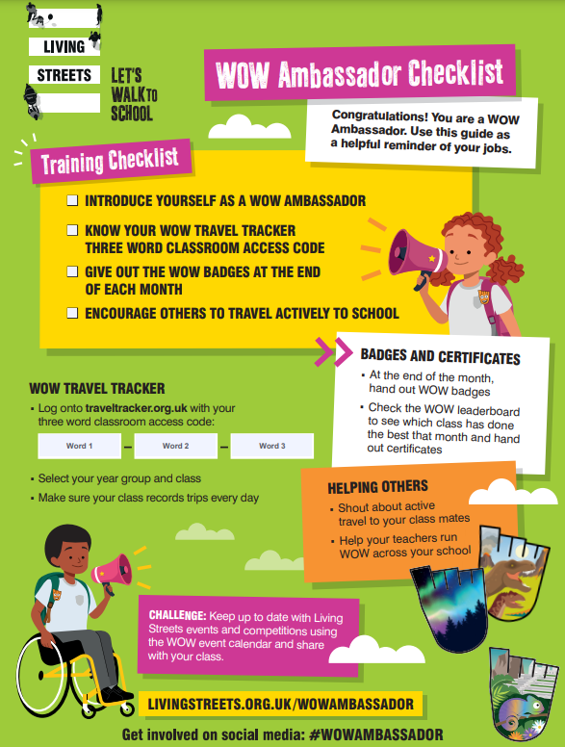
WOW AMBASSADORS
Notes:
WOW Ambassador is an important role a pupil can take on to support the delivery of WOW in your school. Their key role is to champion all things WOW in their class and across the school, encouraging other pupils to walk or travel actively to school. They may also assist with recording journeys on the WOW Travel Tracker, mark absent children absent, and take the responsibility of awarding WOW badges at the end of each month.

Slide 20
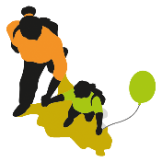
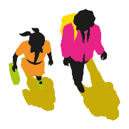
QUIZ TIME!
1. WHAT IS PARK AND STRIDE?
2. WHAT DOES IT MEAN TO TRAVEL "ACTIVELY" TO SCHOOL?
Park and Stride means parking the car
10 minutes away from school and walking or wheeling the rest of the journey. This way you can still earn a badge!
It means you are using the power of your body
to travel somewhere. Examples of 'active' travel are
walking or wheeling (using a wheelchair or mobility
aid), cycling, skating and scooting.
3. WHAT ARE THE BENEFITS OF WALKING AND WHEELING TO SCHOOL?
Walking and wheeling is a form of exercise, and it keeps us healthy
It’s great for our minds and bodies
Opportunity to spend time with our families
By walking and wheeling we help reduce pollution
Great for the planet
Notes:
**Optional slide

Slide 21


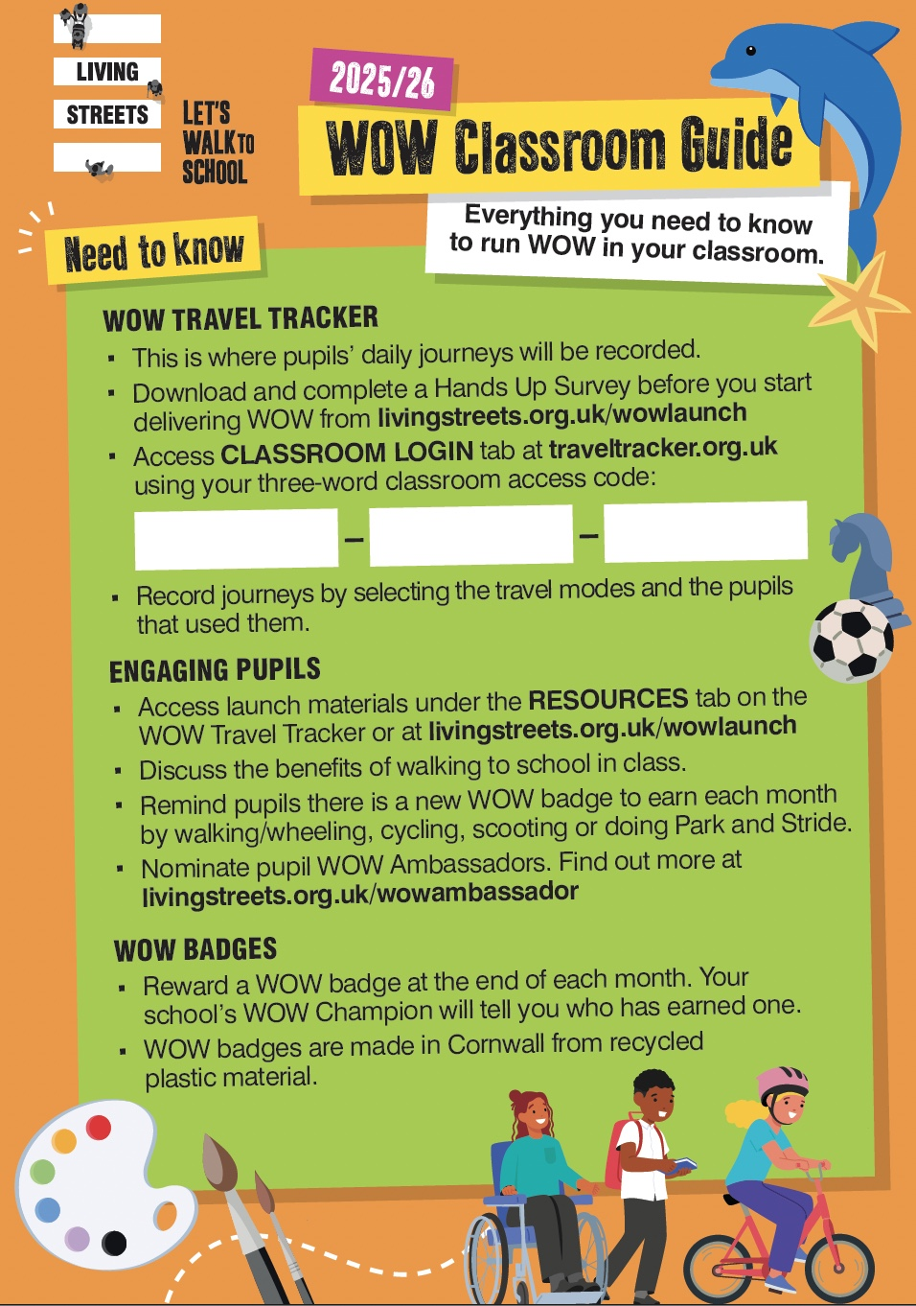
FINAL CHECK
Make sure you have your classroom guide with your three-word access code to access the WOW Travel Tracker.
Appoint your WOW Ambassadors to encourage everyone to log their trips and award badges.
Log on at traveltracker.org.uk and start recording your activity!
Notes:
​ You are now ready to start your challenge.
Good luck and I hope you enjoy being active and earning lots of badges.]

Slide 22
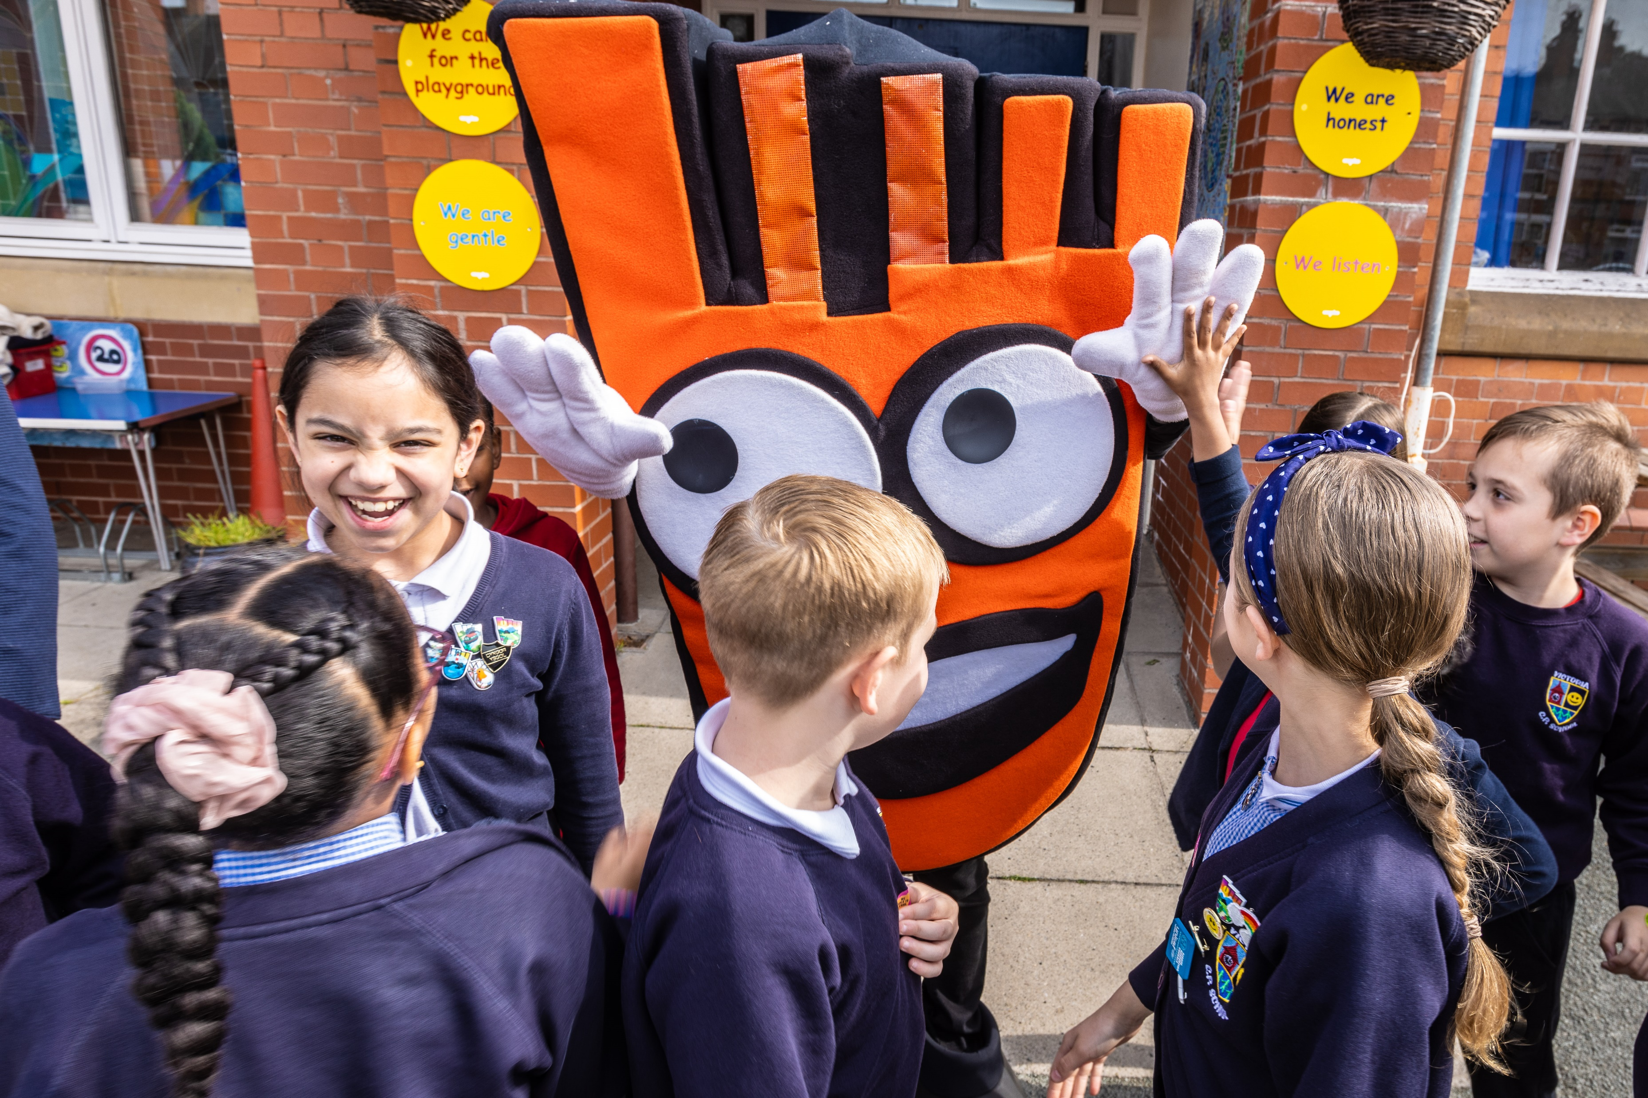
YOU CAN FIND MORE USEFUL RESOURCES, VIDEO AND FAQS AT: livingstreets.org.uk/wowlaunch
LOG ON TO THE WOW TRAVEL TRACKER AT: traveltracker.org.uk
Notes:
Thank you everyone and see you soon!

