Slide 1
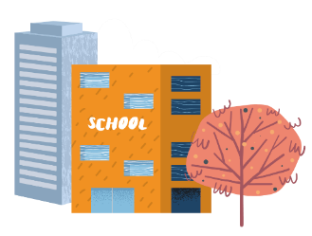




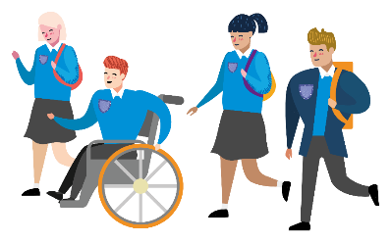
Travelling to your new school
Notes:
[Use this PPT to facilitate a short session on the summer transition day, either in the classroom or an assembly].
[Before you start, give each pupil a booklet from the classroom pack to work through during the session]
Hello and welcome to Next Steps. This presentation is designed to support your Next Steps to Secondary School.
This will help you to consider how you will get to/from your new secondary school in lots of different ways.
You will now be given a booklet, if you have not been given one yet.

Slide 2

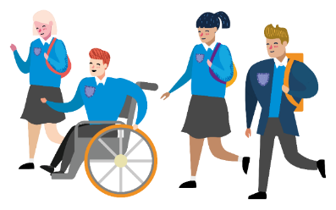
STARTING AT A NEW SCHOOL
IS REALLY EXCITING!
What do you think will be different?
Notes:
You may be thinking lots of different things about going to secondary school.
During this session we’ll be thinking about how you are feeling, what you need to think about before you start and what might be different for you when you start secondary school.
So, what do you think might be different?
[Prompts: lessons, what you take with you, school dinners, people, teachers, place, size and TRAVEL]
Moving to secondary school is an exciting time, there are lots of things to think about and how you travel to and from your new school is one of them!

Slide 3


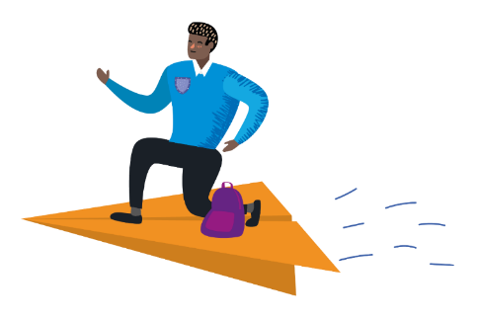
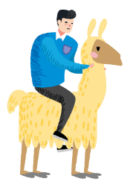





How could you travel to school?
Notes:
How you travel to secondary school might be different to how you travel to primary school.
Your teachers will ask some of you to share how you might travel to your new school. Everybody’s journey is likely to be different and it’s important to find the best option for you.

Slide 4
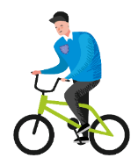

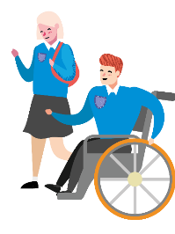
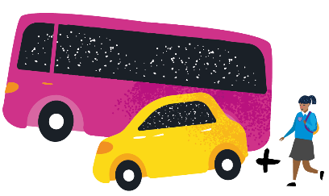
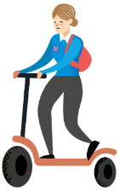

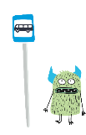
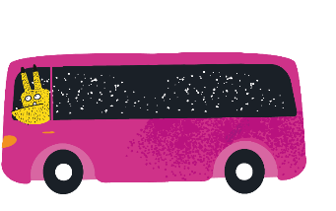
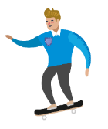
There are lots of ways to travel…
Notes:
There are lots of ways to travel, which you are likely to have talked about. You might walk / wheel all the way to school, This includes those walking with mobility aids, such as wheelchairs or wheeled walkers. You might Cycle / scoot / skate. You might get public transport – using buses and trains to get you to the school gate, or perhaps traveling directly to school by car or taxi. You may choose that you could walk part of the way – this combines public transport, car or taxi with a walk at the end to complete the journey. For example, getting out the car or off the bus a 10-minute walk from school, then walking / wheeling from there.

Slide 5
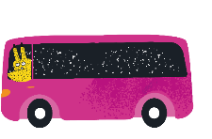

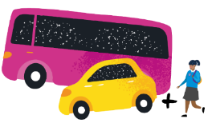







What’s good about each way of travelling?
Free and no equipment needed
PUBLIC TRANSPORT
5
Makes me feel good
WALK PART OF THE WAY
Time with my friends
Doesn’t cause pollution or climate change
WALK/WHEEL
Gives me more independence
Makes me feel wide awake
Helps me stay healthy
Weather won’t stop me
CYCLE/SCOOT/SKATE
Doesn’t take too long
CAR OR TAXI
Easy for me
Notes:
Turn to the activity on pages 3 and 4 of your booklet.
The aim of this activity is to connect the ways of travelling with the benefits that apply to you. There are 10 green boxes that give examples of the ways you can benefit from that mode of travel. You might have a chance to travel with friends and have more independence travelling without your parents. Some of you will get a free travel pass. If the bus stop or station is close to your home, it might be an easy option for you.
Everyone’s journey will be different.
Spend some time chatting with the person next to you and completing the activity in your book about the benefits of catching the bus or train between your home and your new school? Work your way through each mode of travel that you can see. Your answers might be different to others as you may live in different areas.
When you are done click on to reveal the answers.

Slide 6

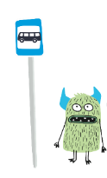


Which mode is
best for you?
PUBLIC TRANSPORT
5
Notes:
Once you have considered each mode of travel, score them by counting the number of benefits you have connected them to.

Slide 7
Which mode is
best for you?
How would you choose to travel?
PUBLIC TRANSPORT
5
Notes:
To finish the activity, complete the orange section, noting which mode of travel got the highest score and therefore which mode of travel would you choose and why?

Slide 8
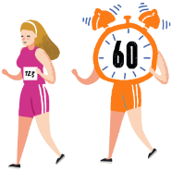


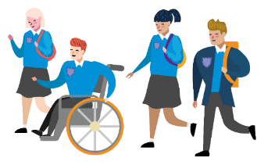
Reasons to move more
on your journey to school
Saves money
Helps you stay healthy
£££
Makes you feel happier
Doesn’t cause pollution
Gives you independence
Time with friends
Notes:
Some of you might need to use public transport or the car to travel to school but keeping active is really important. Think of some reasons why it could be good to incorporate being active on your journey, then click through to reveal some reasons we came up with.

Slide 9


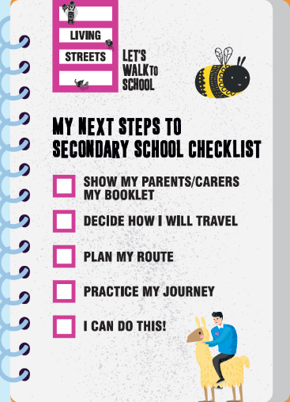


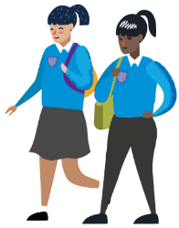
How will you travel to your new school?
Notes:
You will be given a magnet each to take home. Put this magnetic checklist on your fridge and complete the tasks in order over the summer holiday:
The tasks are:
Show my parents or carers my booklet - talk to your family about the benefits of the different ways of travelling to school.
Decide how you will travel - which option is best for you?
Plan your route - which way you will walk or cycle, or where will you catch the bus?
Practice your journey - you could do this with family or with friends who you will be travelling to school with.
Finally – you can do this! - once you’ve done this, you’re ready to go.

Slide 10


