Slide 1

Notes:
Holding slide whilst children are entering assembly hall.

Slide 2


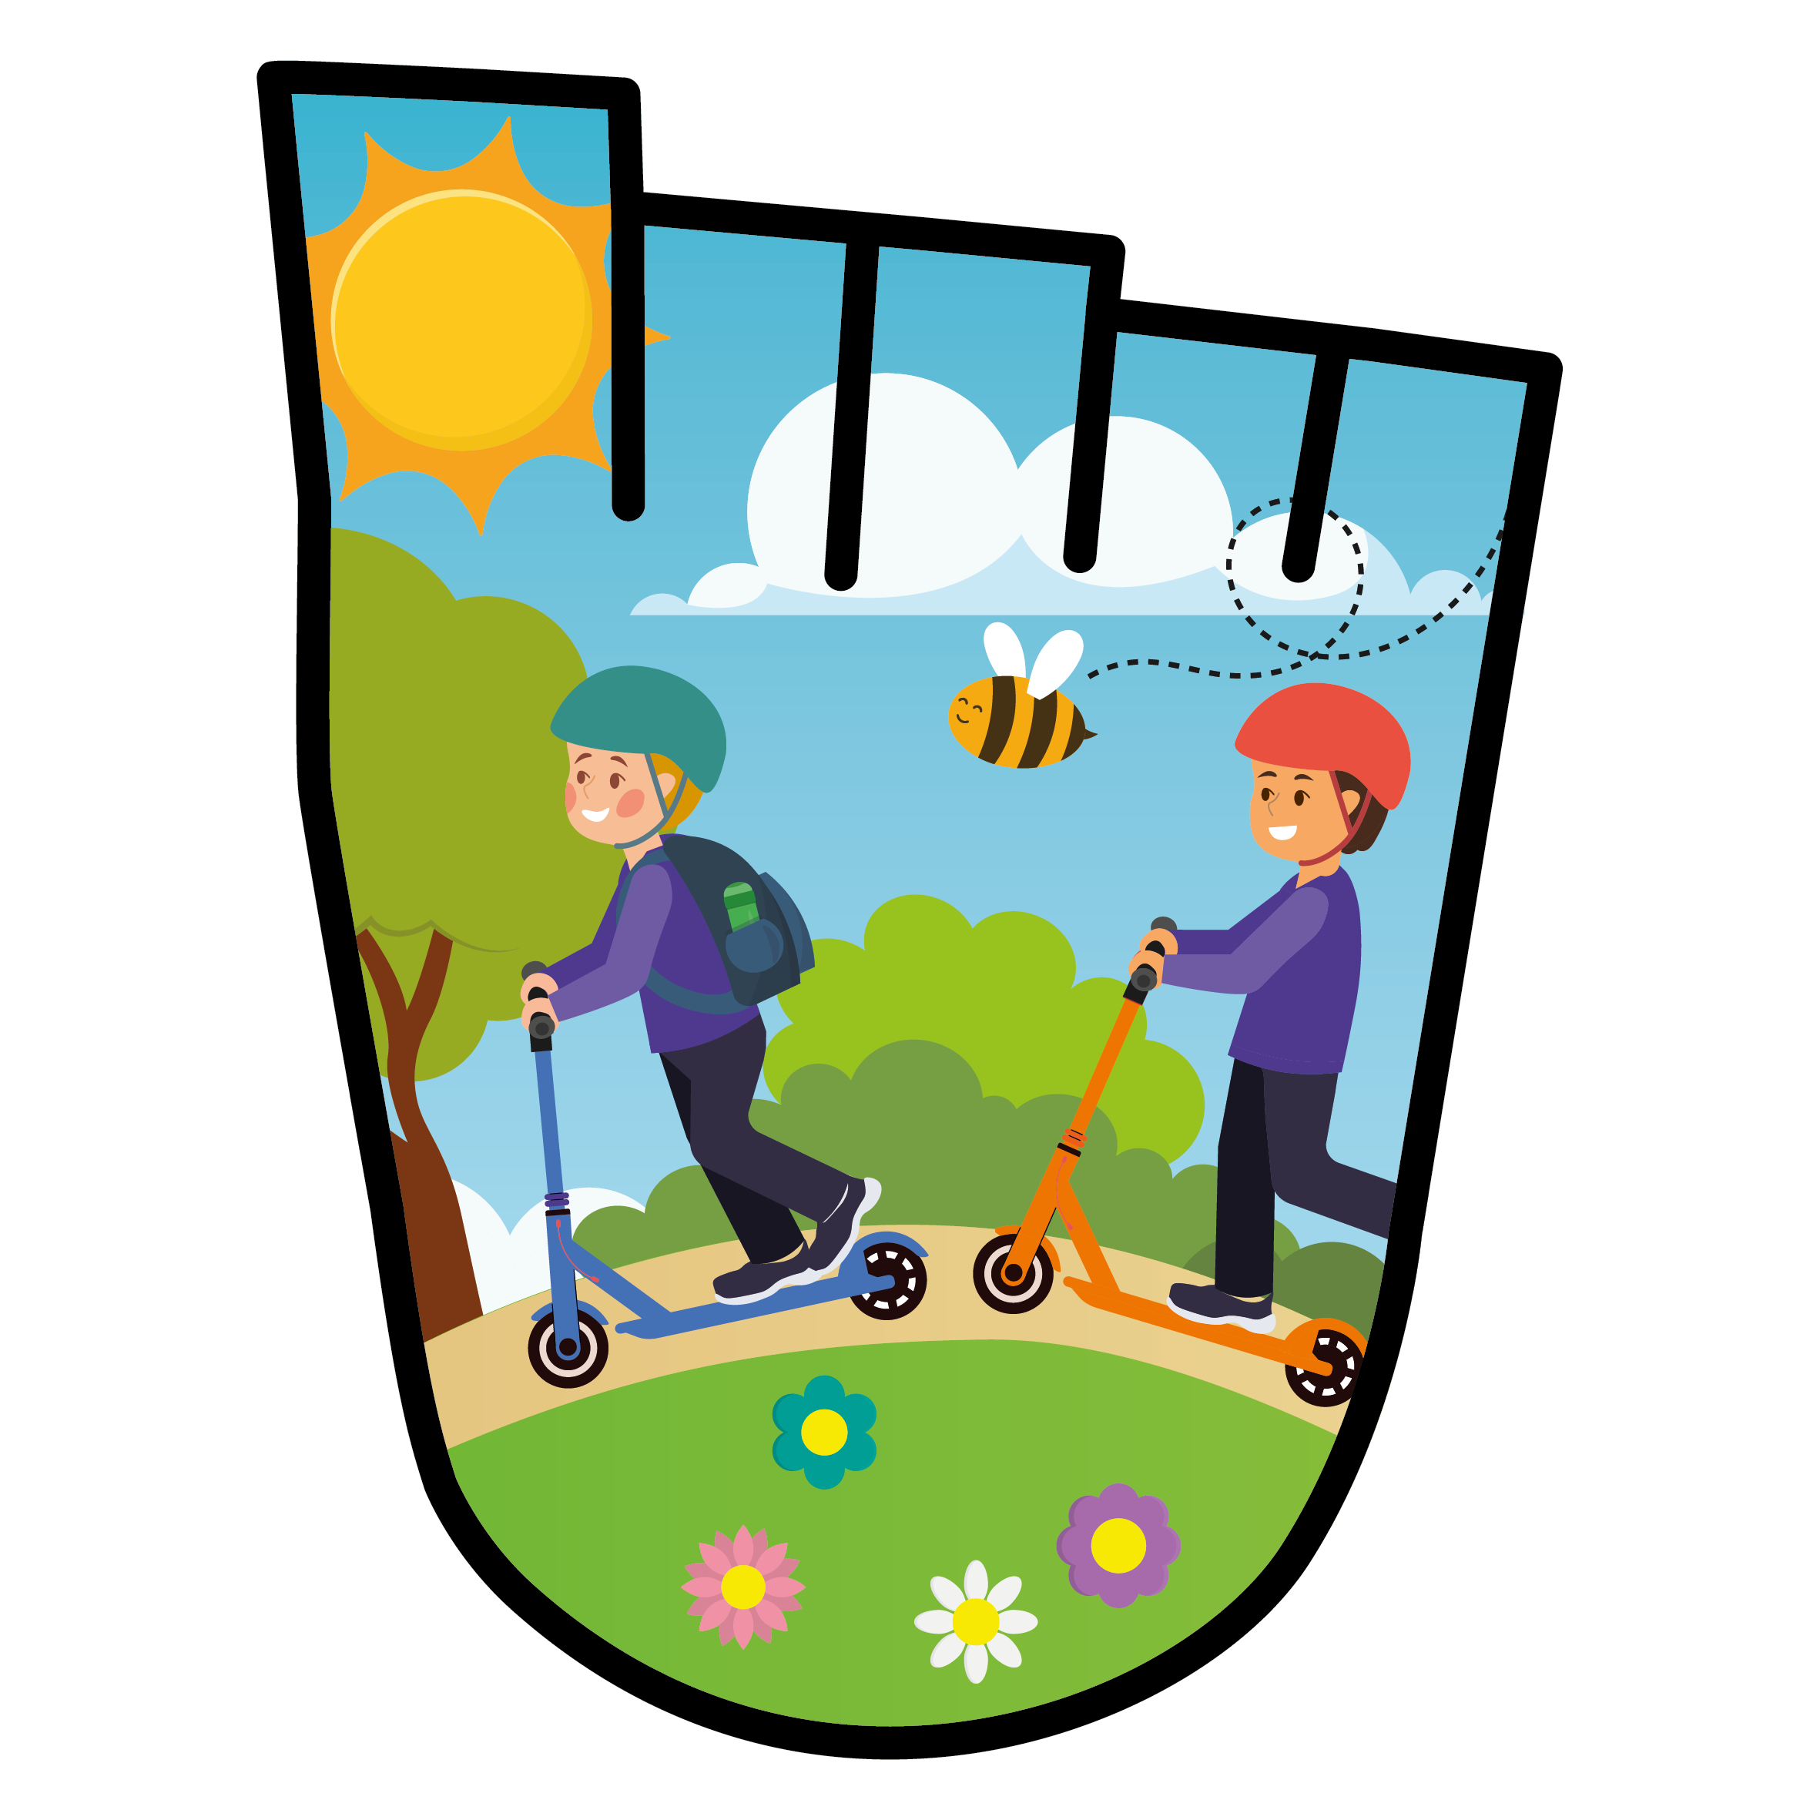


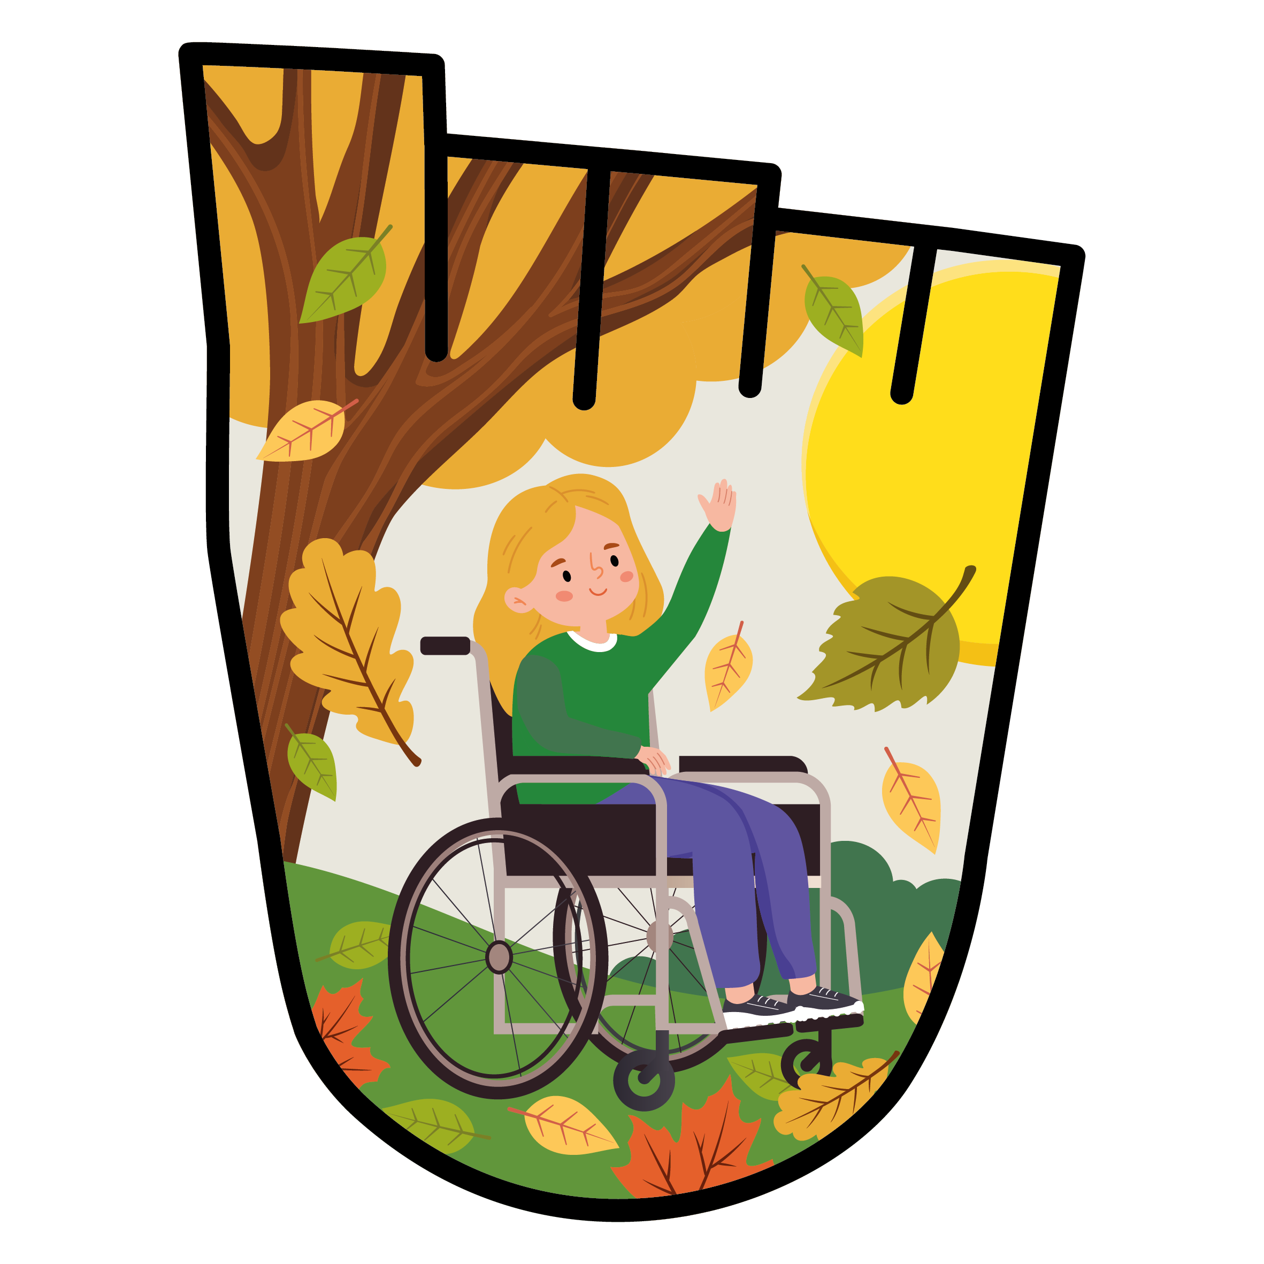
WELCOME TO WOW
Hello, my name is XXXX and I work for
Living Streets - the UK charity for everyday walking.
I look forward to seeing how many of you are
walking or travelling actively to school!
Notes:
Hello everyone, I’m xxxx from Living Streets, the UK Charity for everyday walking. I’m here to talk about walking to school and the reason for that is, starting tomorrow/next week, your school is taking part in WOW, the Walk to School challenge. The great thing about WOW is that it doesn’t just last for a week, or a month, but it will run for the whole of the school year! The even better news is that you can earn special badges, like these on the screen, just by walking to school – or, travelling actively, and we’ll come to that soon. Put your hands up if you like a challenge!
(If not showing the video next) – ‘Before I tell you how the challenge works, I want you to have a think about how you travelled to school today. How did you reach the school gates?’

Slide 3

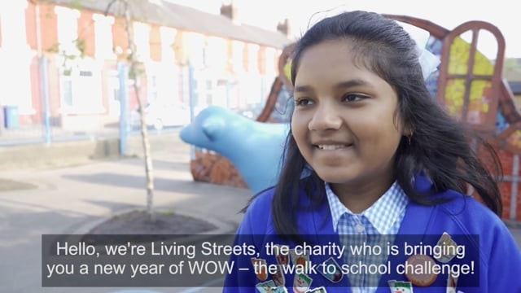
WHAT IS WOW?
Notes:
**Optional video slide – video is 2 mins 30 secs long
You are now going to see a short video all about WOW, and what you need to do to take part.​
Enjoy the video! Watch carefully, there will be questions afterwards

Slide 4
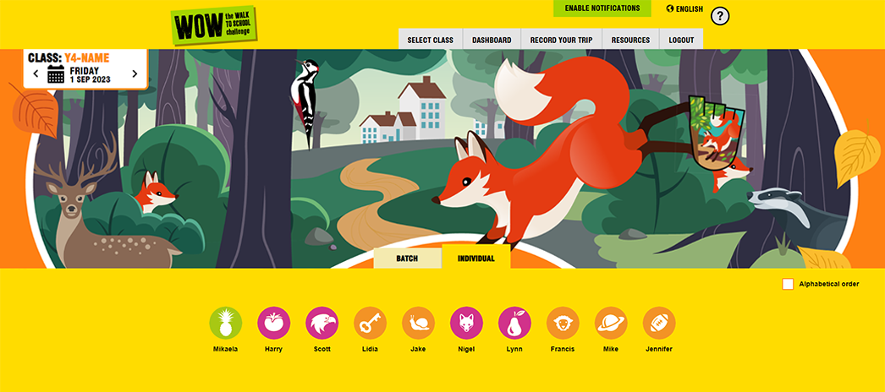
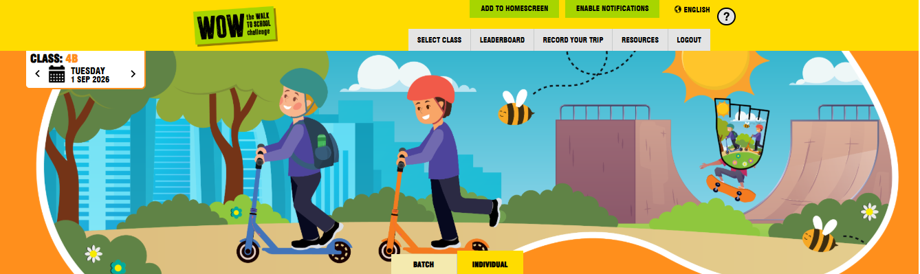



WOW TRAVEL TRACKER
Notes:
NB If the school is set up – you could show them their account and they will see their names instead of slide 5-8
As we’ve learned from the video, the Travel Tracker is the place you will go onto everyday to record your trips to school. Your teacher or a pupil WOW Ambassador will log onto your Travel Tracker Account using your 3-word access code. They will then select your class and come to a page like this. You can access Travel Tracker and log journeys on the Interactive White Board, an iPad or a computer, whichever your teacher thinks is easiest for the class.
There are few things to point out.
Can you spot the badge on the right-hand side? Here, you will see which badge you are trying to earn each month.
There is a calendar at the top left to show you are logging your journey for today. If you have missed a day, you can use this to go back and log the journeys you missed. We suggest you log your journeys daily as this makes it more accurate, and always check the calendar is set on the correct date before logging.
Below, you can see lots of circles with white pictures inside. You will have a picture, and there is one for each of your classmates. Just above them there is an option to log your journeys individually or as a batch.
If you are doing it individually, simply select your picture. This will take you to the next page.

Slide 5
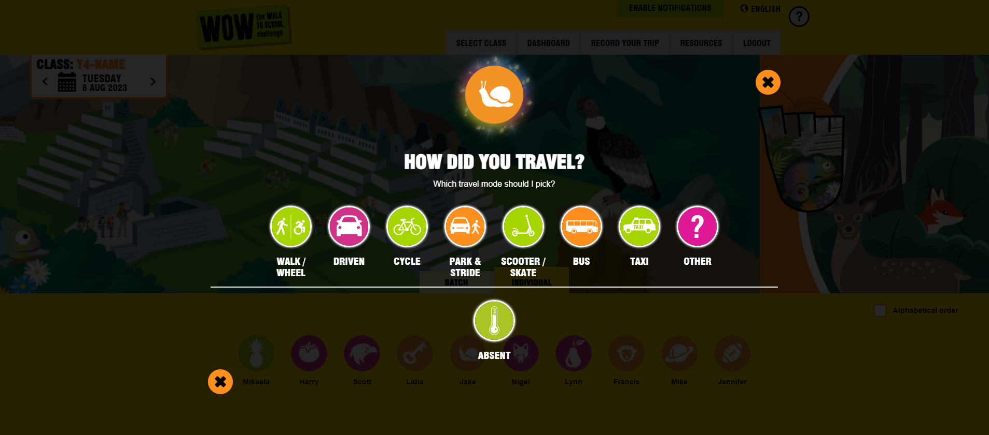
WOW TRAVEL TRACKER
Notes:
Once you select your icon, you will be brought to this page, where you record how you came to school. Select the one that best suits you. If you selected the wrong picture by mistake, just click on the cross to go back.
If you are recording for someone who is not at school today, select ‘Absent’. This is really important as it will give them a fair chance of earning a badge like everyone else. The next slide explains the batch recording option instead of individual recording.]

Slide 6
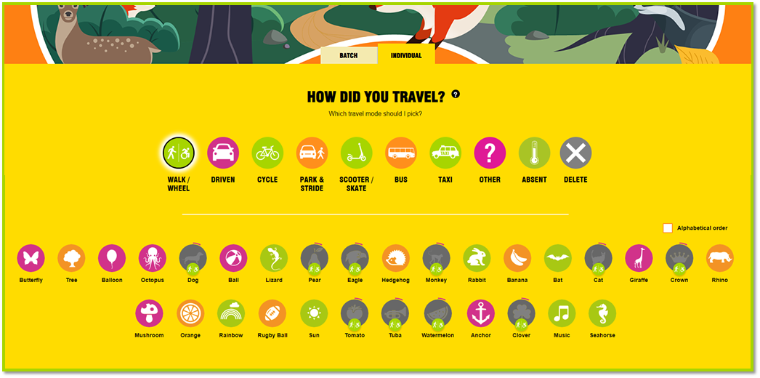
WOW TRAVEL TRACKER
BATCH ENTRY
Notes:
This option allows the teacher or a pupil to record journeys for the whole class. Select the type of transport, for example ‘who walked/wheeled the whole journey to school?’ all those with their hands up can be selected. Go through each type of transport until everyone’s journey has been recorded. The next slide shows how you can see which classes and schools are recording and who is making the most active journeys.

Slide 7
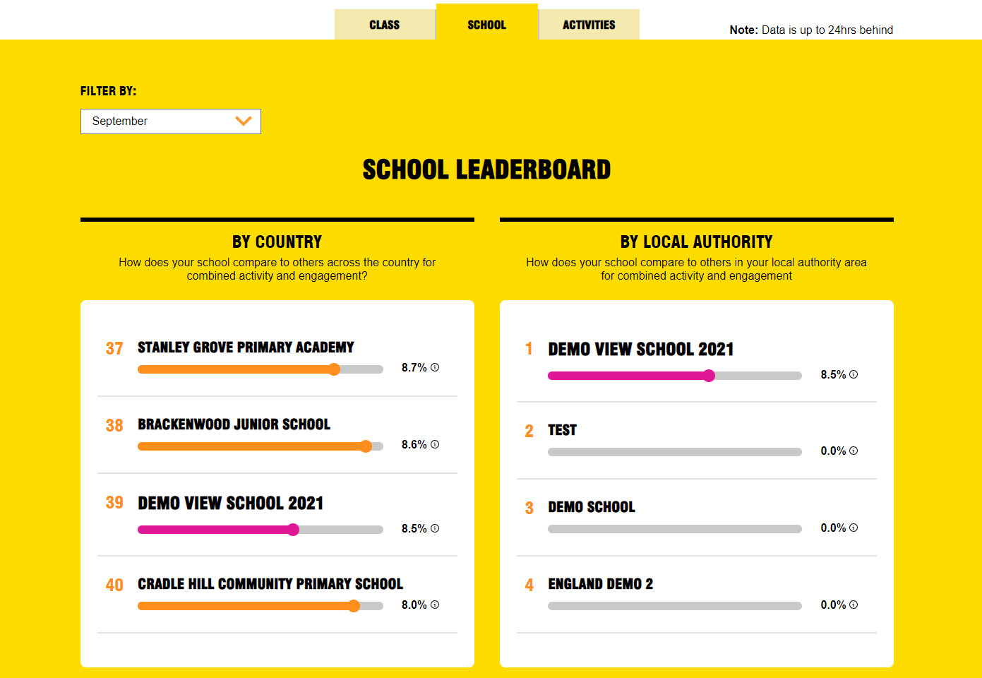
WOW TRAVEL TRACKER
LEADERBOARD
Notes:
This is a great way to get some healthy competition going; between classes, but also between schools in the local area or nationally! You can access the leaderboard page by clicking on the LEADERBOARD tab on the main page. Here, you can select the ‘class tab’ to see the class of the month or select the ‘school tab’ to see your school’s position on the local or national leaderboard. We have a selection of editable certificates that your teacher or WOW Ambassadors can award to the top classes or to the whole school during assemblies! For those who love maths, you can work out how far ahead they are or what they need to do to pick up the pace. You teacher can even check how well you are doing compared to other schools.

Slide 8












OCTOBER
NOVEMBER
DECEMBER
JANUARY
Which WOW badge is
your favourite?
FEBRUARY
SEPTEMBER
MARCH
JULY
JUNE
MAY
APRIL
Notes:
Now the moment you’ve been waiting for……the badges! This year’s theme is Walk the Senses, so all of the badges show things that children said they could either see, hear, touch, taste, or smell on their journeys to school.
All of the badges have been designed by children who took part in the WOW challenge last year. Now, have a look and decide which is your favourite.
In a moment, your teacher can call out each badge by month and you can put your hand up when it’s your favourite. Remember to put your hand up just once, and put it straight up and straight down so you don’t bash the person next to you! I wonder which badge will be the most popular?

Slide 9
QUIZ TIME!
1. WHAT IS PARK AND STRIDE?
2. WHAT DOES IT MEAN TO TRAVEL ACTIVELY TO SCHOOL?
Park and Stride means parking the car
10 minutes away from school and walking the rest of the journey.
This way you can still earn a badge!
It means you are using the power of your body
to travel somewhere.
Examples of 'active' travel are; walking (using a wheelchair or mobility aid), cycling, skating and scooting.
3. WHAT ARE THE BENEFITS OF WALKING TO SCHOOL?
Walking is a form of exercise, and it keeps us healthy
It’s great for our minds and bodies
Opportunity to spend time with our families
By walking we help reduce pollution and it is great for the planet!
Notes:
Now, let’s see what you can remember by trying this quiz page!

Slide 10

FINAL CHECK
Make sure you have your classroom guide with your three-word access code to access the WOW Travel Tracker.
Appoint your WOW Ambassadors to encourage everyone to log their trips and award badges.
Log on at traveltracker.org.uk and start recording your activity!
Notes:
All that remains to be said is to try to remember all those great reasons you came up with for walking during the quiz. I can guarantee the more you walk, scoot or cycle to school - it will brighten up your day and those around you.
​
​ You are now ready to start your challenge.
Good luck and I hope you enjoy being active and earning lots of badges.

Slide 11
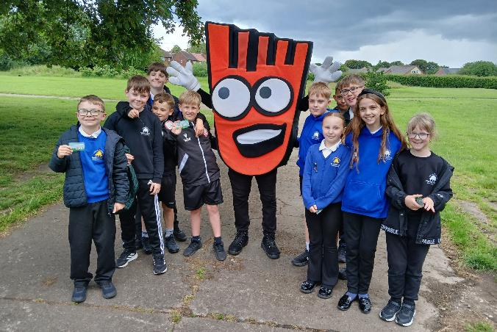
THANK YOU!
FIND RESOURCES, VIDEO AND FAQS AT: livingstreets.org.uk/wowlaunch
LOG ON TO THE WOW TRAVEL TRACKER AT: traveltracker.org.uk
Notes:
Thank you for watching this. We hope you love the WOW challenge, and – happy walking !!

