Slide 1
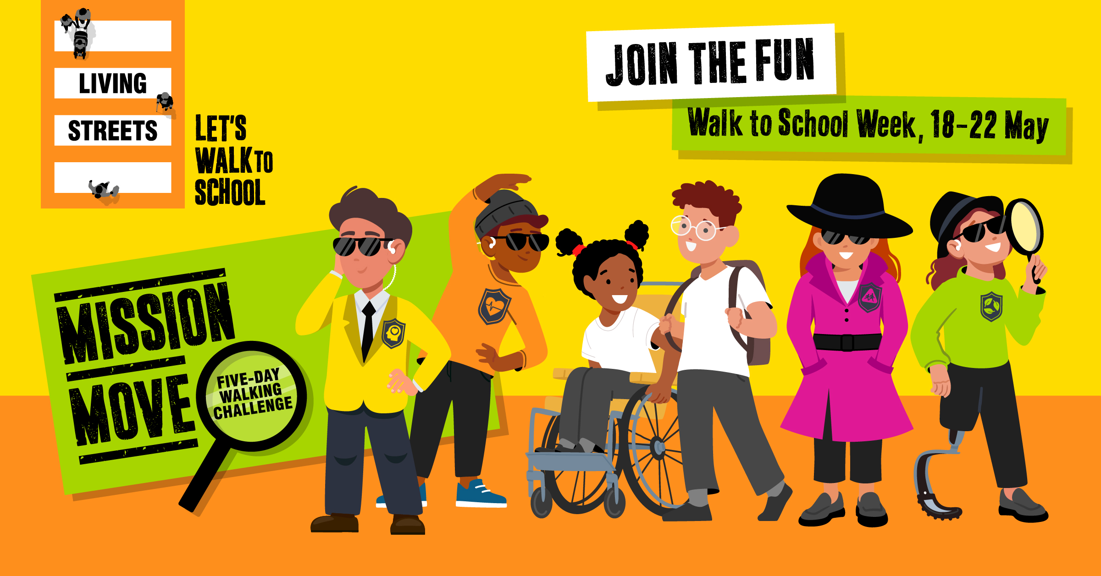
Notes:
Title Screen

Slide 2


WALK TO SCHOOL WEEK
This month, we'll be taking part in a very special challenge called Walk to School Week!
Walk to School Week is a celebration of walking and wheeling to school.
This challenge will be taking place from Monday 18 May to Friday 22 May.

Slide 3
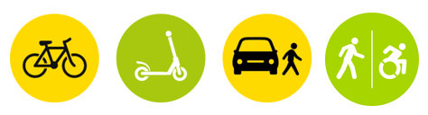
WALK TO SCHOOL WEEK
During Walk to School Week, we would like you to walk, wheel, cycle, scoot or Park and Stride to school as much as you can.
Sometimes we call this active travel. Does anybody know what this means?

Slide 4
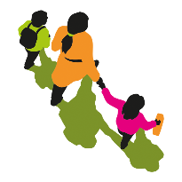
WALKING AND ACTIVE TRAVEL
Active travel means that you are using the power of your body to travel somewhere. Examples of 'active' travel are walking, wheeling (using a wheelchair or mobility aid), cycling, skating or scooting.
During Walk to School Week, we would like you to travel actively as much as you can!

Slide 5
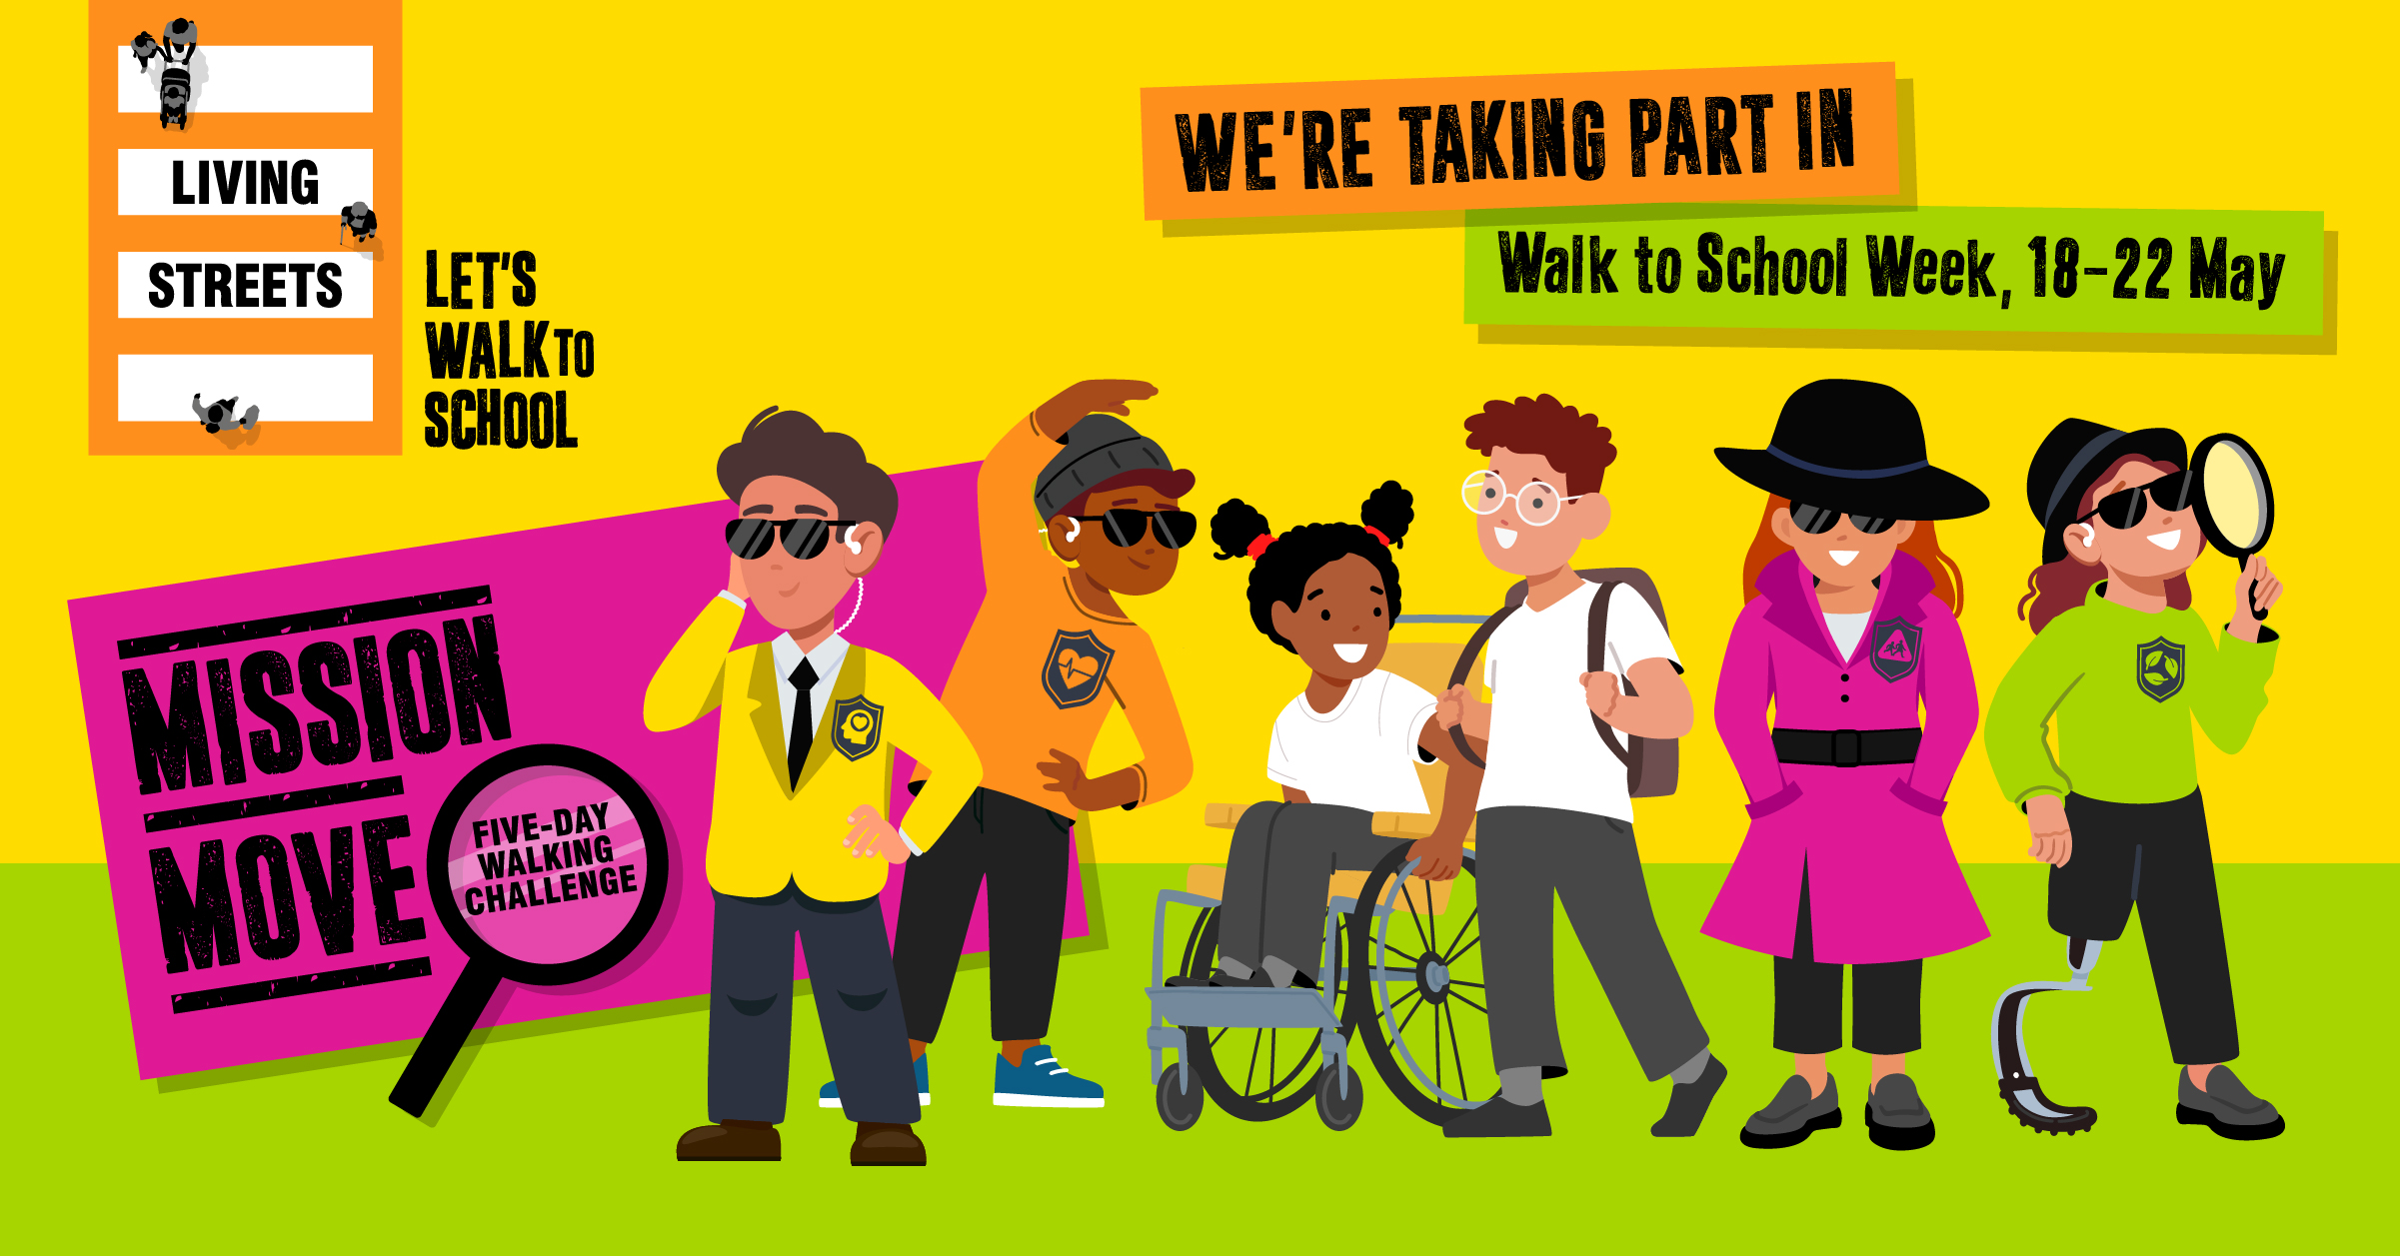
WHY SHOULD WE WALK OR WHEEL?
There are many reasons why we should choose to walk or travel actively to school and taking part in Walk to School Week is going to help us learn more about it.
Can you think of some reasons why we should walk or wheel to school?
Notes:
Answers from pupils may include:
Physical health
Mental health
Nature
Good for the environment
Wellbeing
Exercise
Spend time with family and friends
Help make streets and roads safer

Slide 6

WHY SHOULD WE WALK OR WHEEL?
There are lots of reasons why we should try to walk and wheel to school as much as we can.
These reasons include:
Better physical and mental health
Helping the environment
Spending time with our family and friends

Slide 7
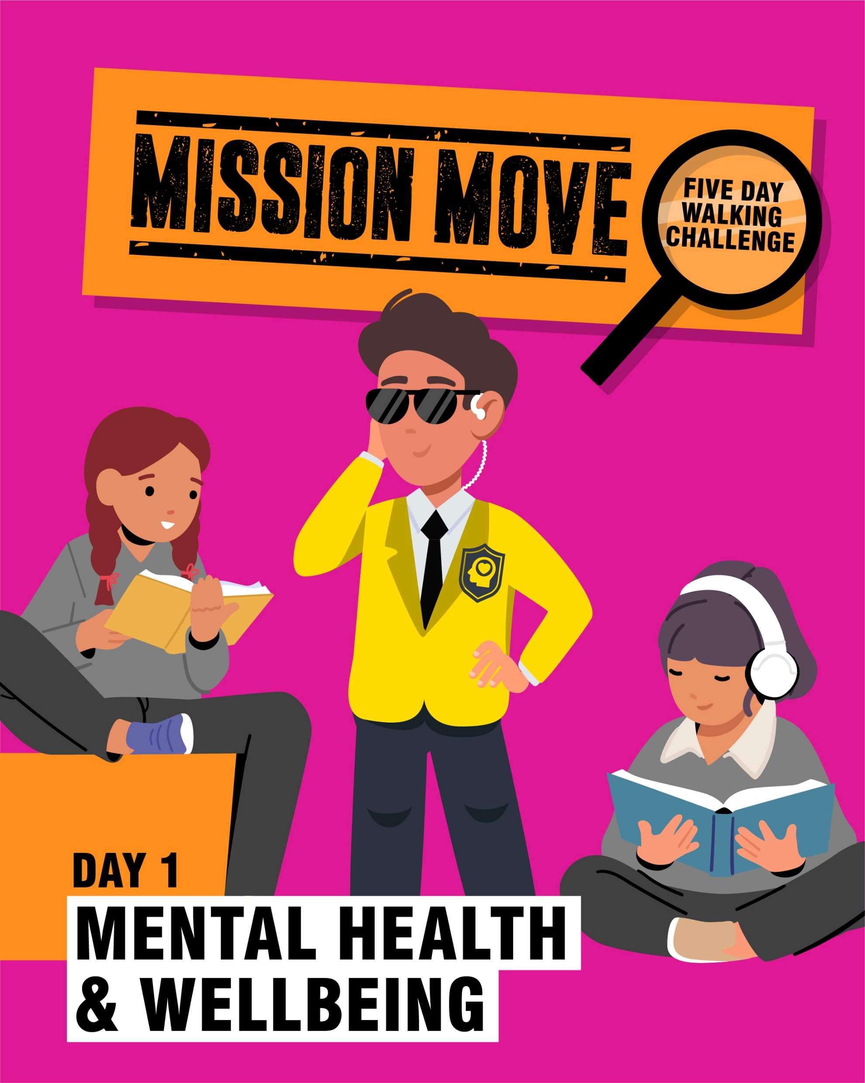
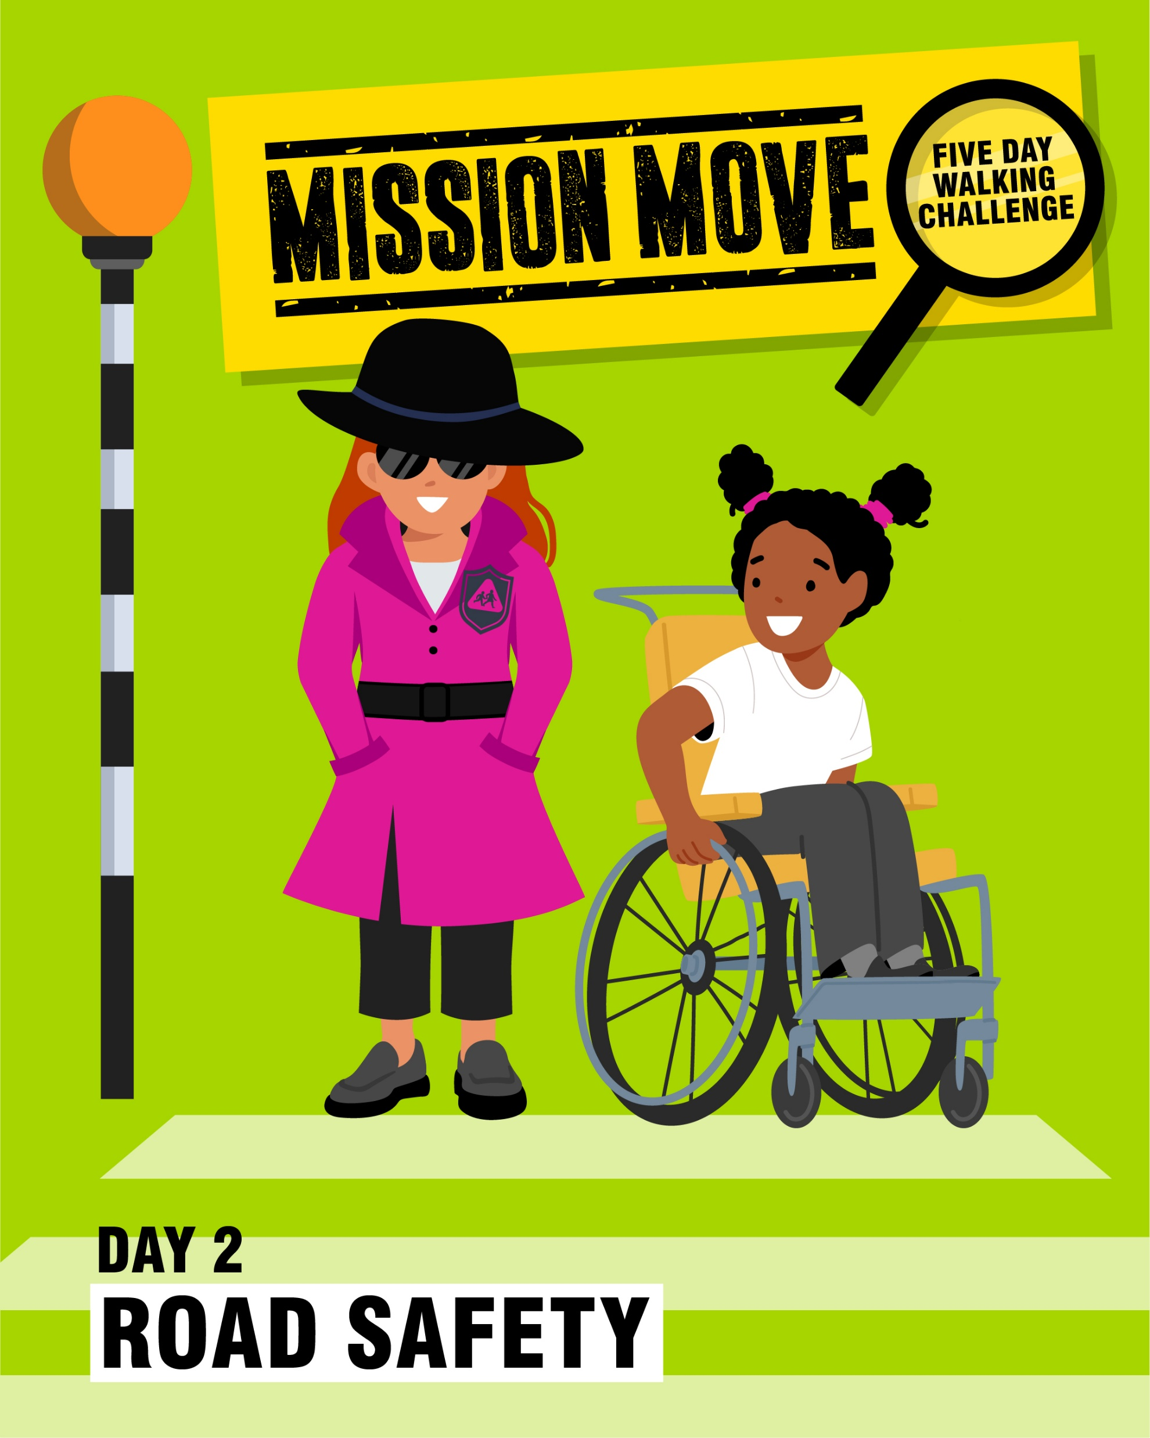
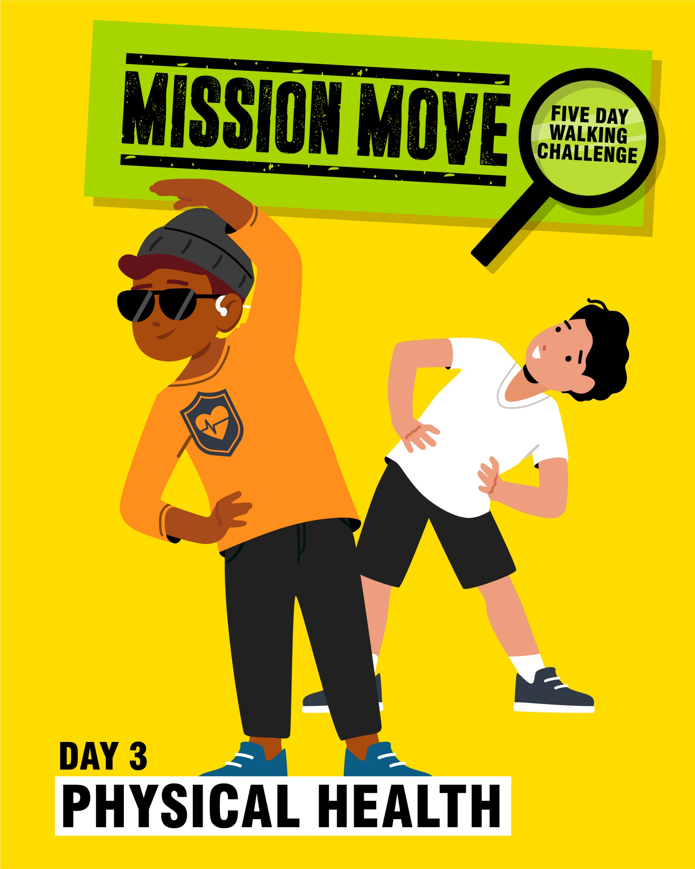
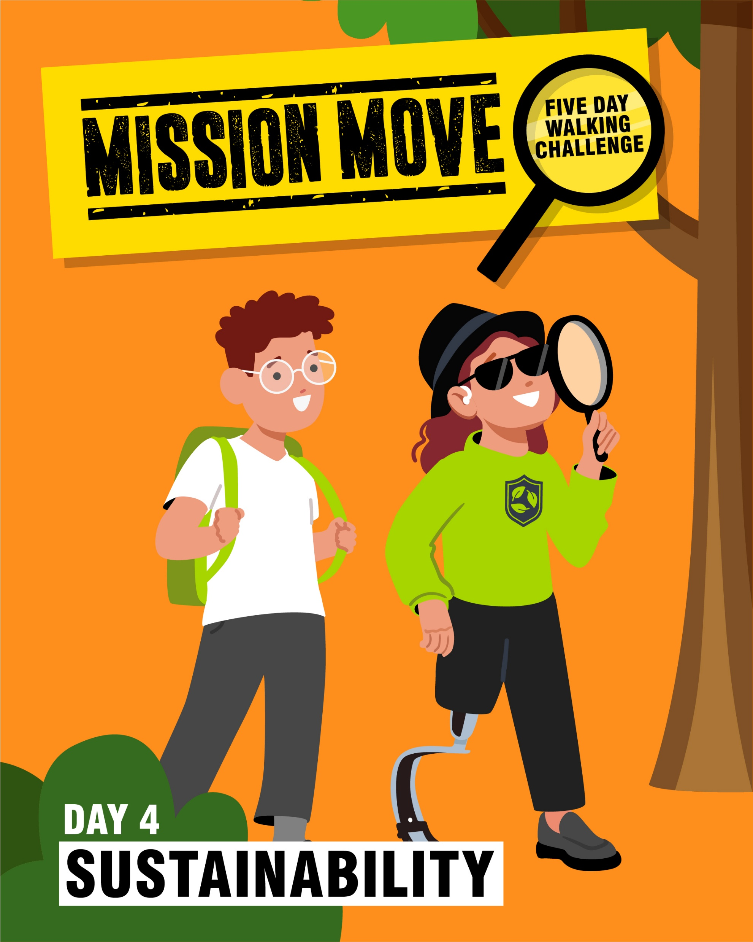
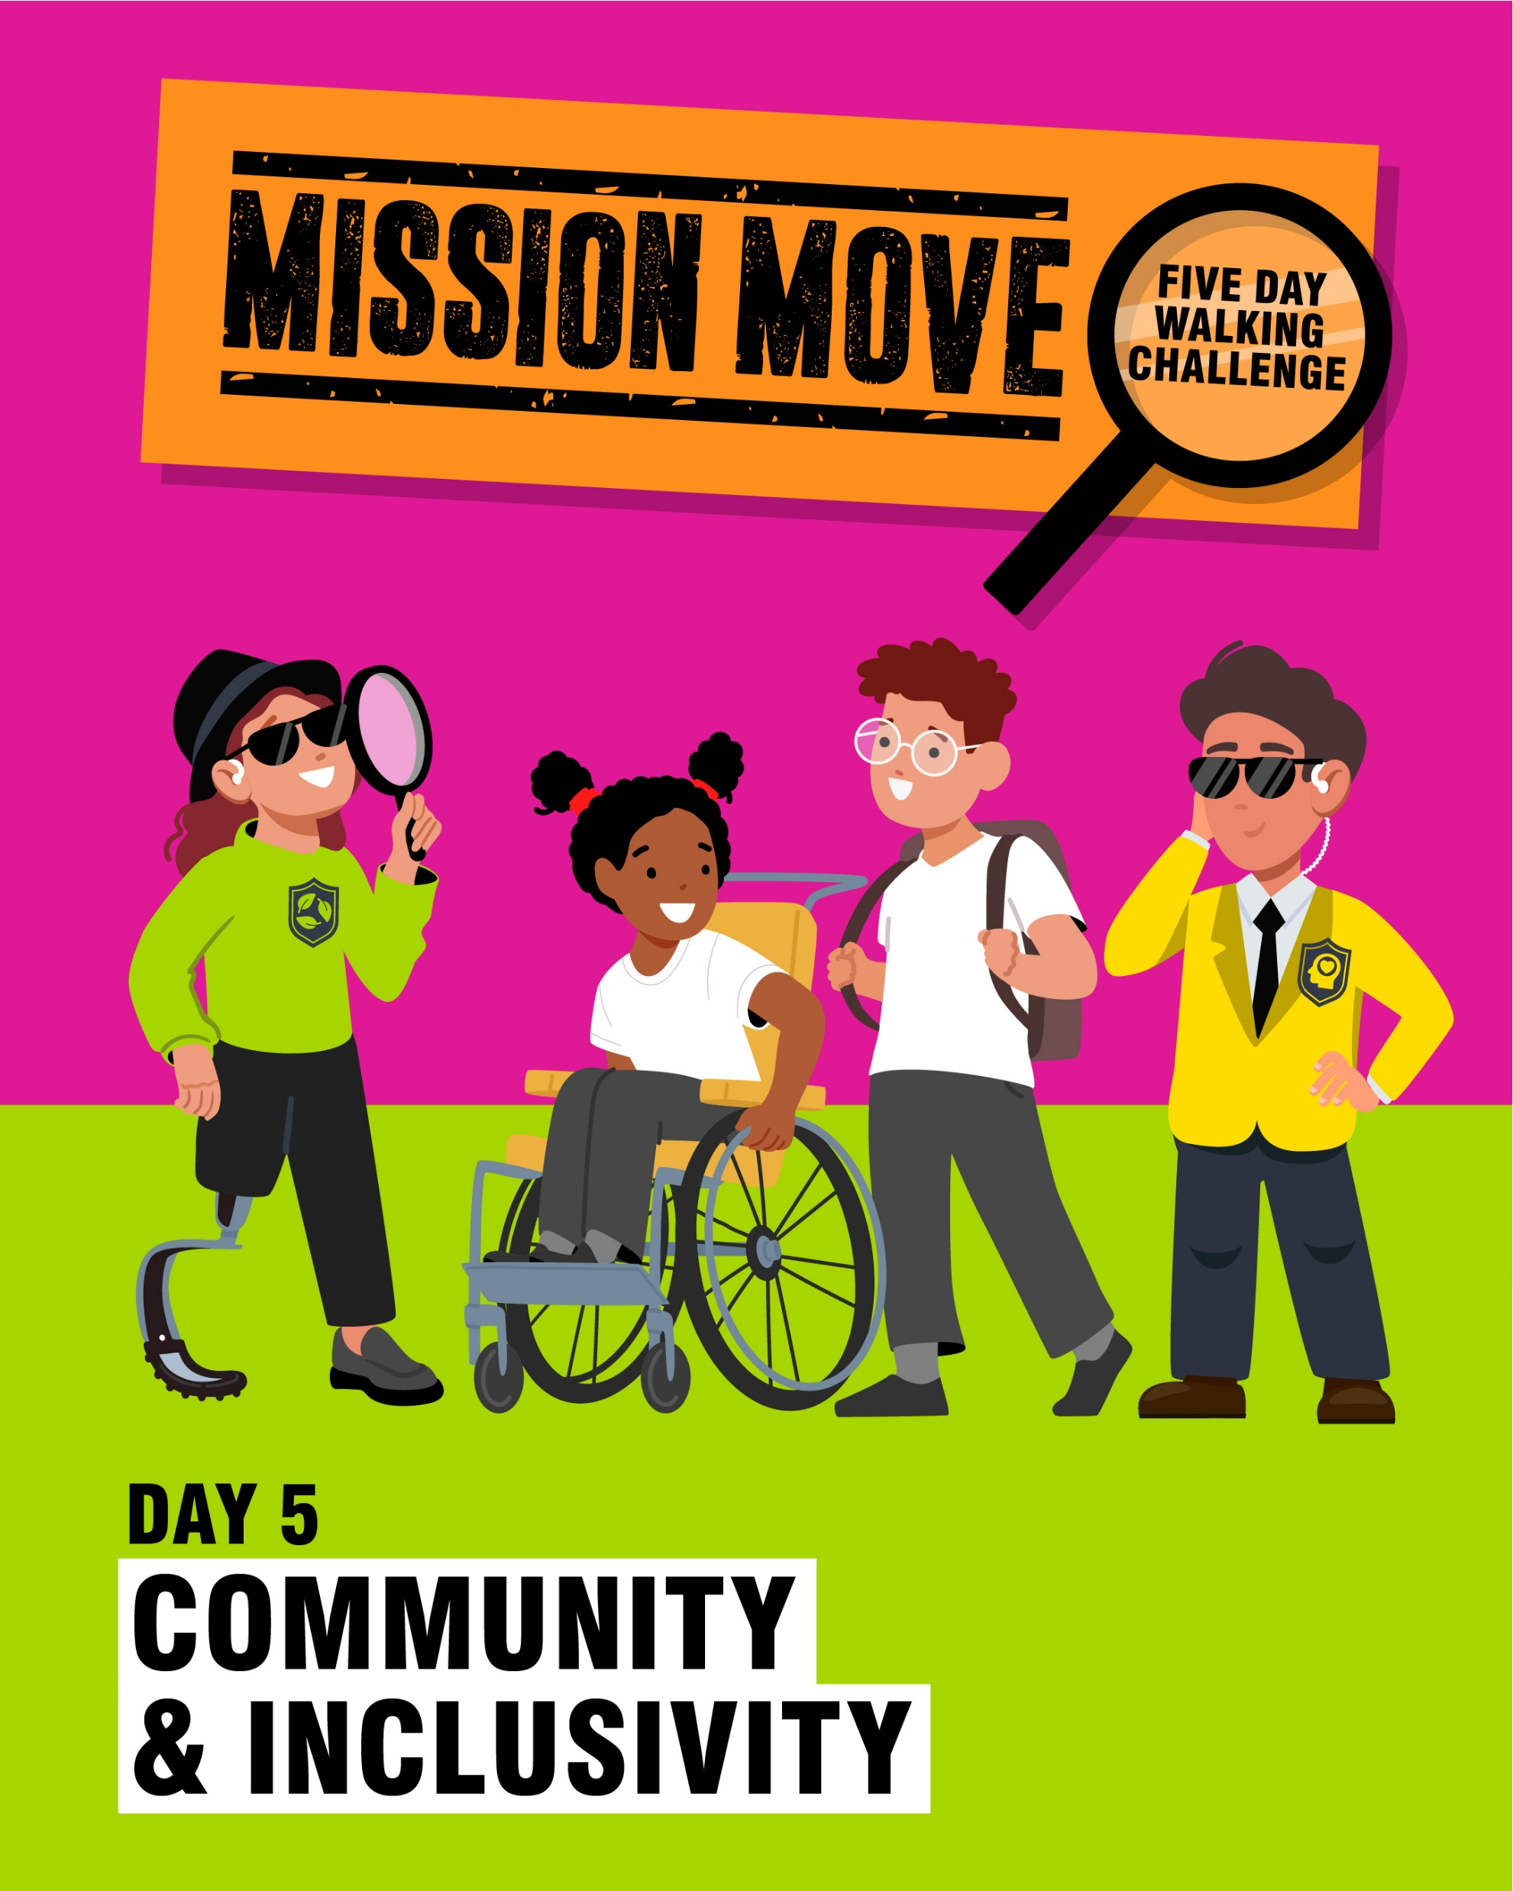
Walk to School Week themes
The Walk to School Week Challenge will help us to understand the benefits of walking and wheeling to school by exploring the themes below!
Notes:
Day 1 of walk to school week discovers mental health and wellbeing through walking. Being outside in nature can help us feel happier and more relaxed. It can also improve our mood!
Day 2 of walk to school week will discover road safety. Choosing to walk instead of taking the car can help us to make the streets outside of our school safer by reducing the number of cars on the road.
Day 3 of walk to school week is all about physical health. Moving our bodies is good for our hearts, lungs, muscles and bones! Walking to school counts as exercise for us!
Day 4 of walk to school week discovers sustainability. Walking is not only good for us, but it’s also good for the environment! Less cars on the road means less pollution.
The last day of walk to school week discovers community and inclusivity. Walking and actively travel helps us to be part of our local community. We get to see lots of people in our local area, including those who have important jobs in our community such as police officers, nurses, firefighters and teachers! Walking to school also lets us spend time with our family and friends.

Slide 8





WALK TO SCHOOL WEEK REWARDS
Each day during Walk to School Week, you'll get a sticker for walking or travelling actively to school.
You might also get a very special end of week reward to celebrate all your hard work!

Slide 9
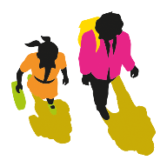



QUIZ TIME
1. DURING WHAT MONTH DOESWALK TO SCHOOL WEEK TAKE PLACE?
2. DURING WALK TO SCHOOL WEEK, HOW SHOULD YOU TRAVEL TO SCHOOL?
Walk to School Week takes place in May. It will be starting on Monday 20 May until Friday 24 May.
You should try to walk and travel actively as much as possible during the week. If you do this, you will receive stickers and a trophy at the end of the week!
3. WHAT ARE THE BENEFITS OF WALKING TO SCHOOL?
Walking is a form of exercise and it keeps us healthy
It’s great for our minds and bodies
It lets us spend time with our families
By walking we help reduce pollution
It's great for the planet

Slide 10
YOU CAN FIND MORE USEFUL RESOURCES, VIDEO AND FAQS AT: www.livingstreets.org.uk/wtsw

