Slide 1


Slide 2






WELCOME TO WOW
Hello, my name is XXXX and I work for
Living Streets - the UK charity for everyday walking.
I look forward to seeing how many of you are
walking or travelling actively to school!

Slide 3

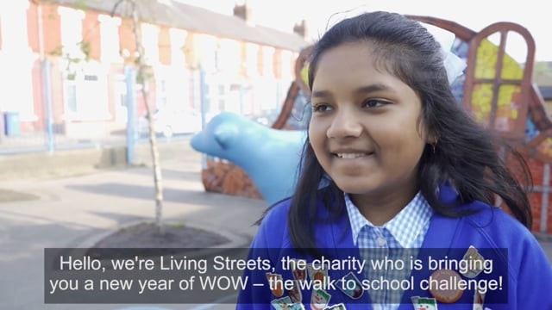
WHAT IS WOW?

Slide 4
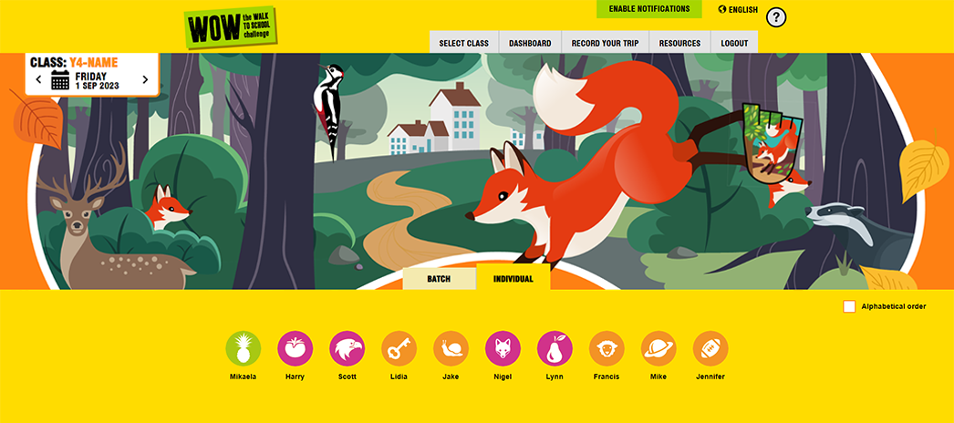




WOW TRAVEL TRACKER

Slide 5
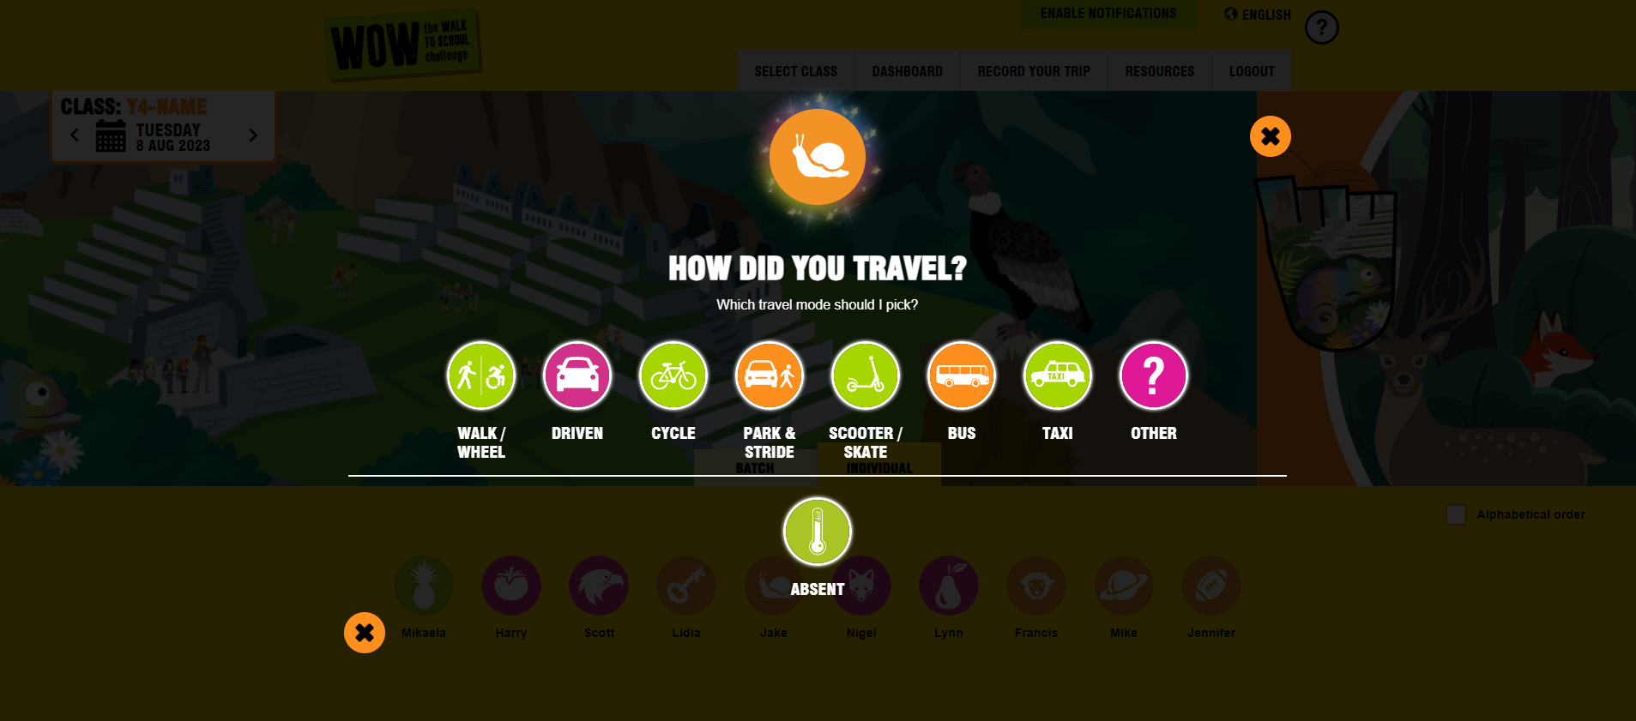
WOW TRAVEL TRACKER

Slide 6
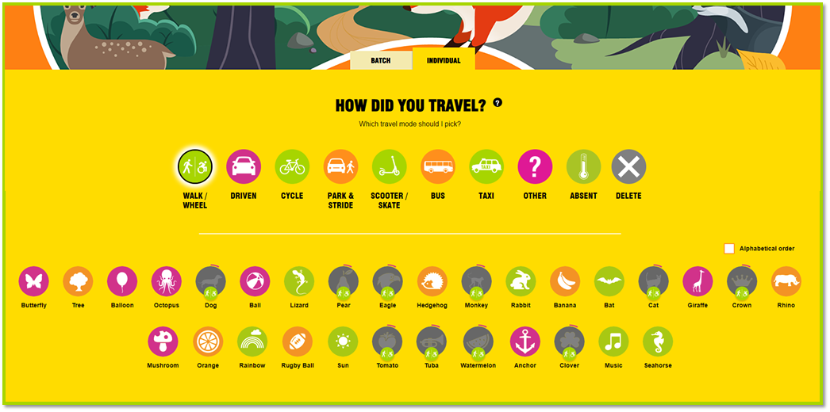
WOW TRAVEL TRACKER
BATCH ENTRY

Slide 7

WOW TRAVEL TRACKER
LEADERBOARD

Slide 8












OCTOBER
NOVEMBER
DECEMBER
JANUARY
Which WOW badge is
your favourite?
FEBRUARY
SEPTEMBER
MARCH
JULY
JUNE
MAY
APRIL

Slide 9
QUIZ TIME!
1. WHAT IS PARK AND STRIDE?
2. WHAT DOES IT MEAN TO TRAVEL ACTIVELY TO SCHOOL?
Park and Stride means parking the car
10 minutes away from school and walking the rest of the journey.
This way you can still earn a badge!
It means you are using the power of your body
to travel somewhere.
Examples of 'active' travel are; walking (using a wheelchair or mobility aid), cycling, skating and scooting.
3. WHAT ARE THE BENEFITS OF WALKING TO SCHOOL?
Walking is a form of exercise, and it keeps us healthy
It’s great for our minds and bodies
Opportunity to spend time with our families
By walking we help reduce pollution and it is great for the planet!

Slide 10

FINAL CHECK
Make sure you have your classroom guide with your three-word access code to access the WOW Travel Tracker.
Appoint your WOW Ambassadors to encourage everyone to log their trips and award badges.
Log on at traveltracker.org.uk and start recording your activity!

Slide 11
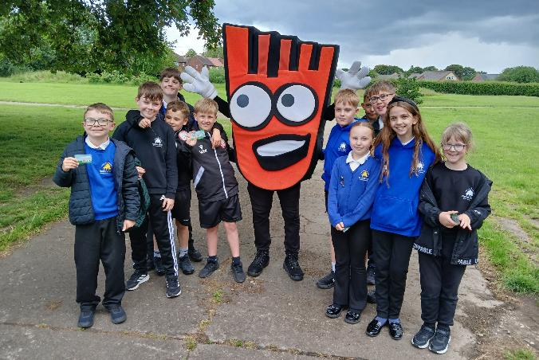
THANK YOU!
FIND RESOURCES, VIDEO AND FAQS AT: livingstreets.org.uk/wowlaunch
LOG ON TO THE WOW TRAVEL TRACKER AT: traveltracker.org.uk

