Slide 1





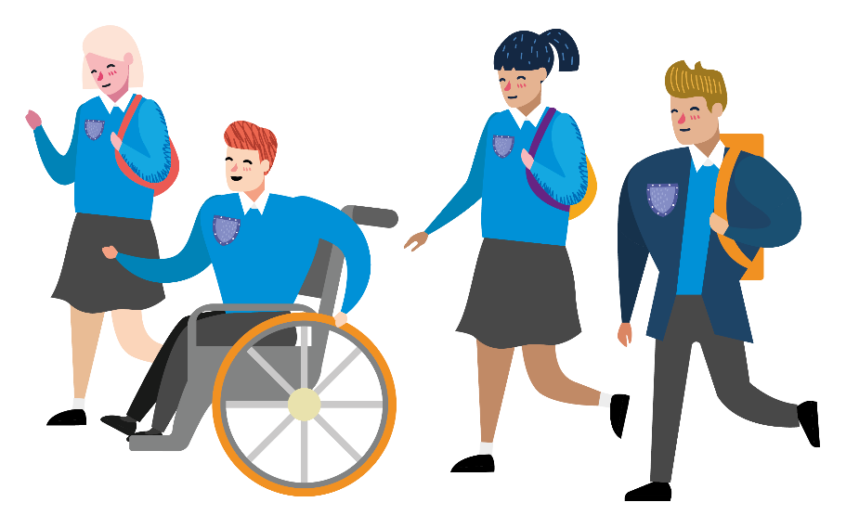
Notes:
Hello and welcome to Next steps. This challenge is brought to you by Living Streets – the charity for everyday walking. The challenge is designed to support you think about your journey to and from school. It will help you to consider the reasons to be active on your journey and explain how you can take part in the challenge.
Before you start, make sure your teacher/ tutor has completed Survey One (found in classroom pack) to record the baseline travel data for your class/ tutor group. They must keep it safe until the end of the challenge, because it will be needed when you finish.

Slide 2



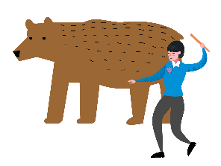


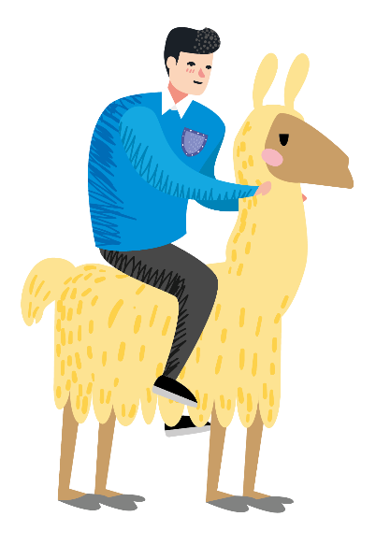


How did you travel to school today?
Notes:
Think back to have you travelled to school today. Put your hand up and share how you travelled to school this morning and why.

Slide 3
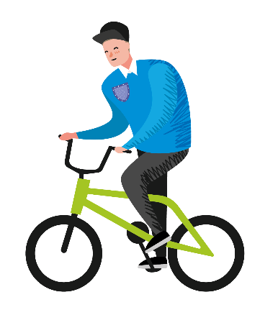

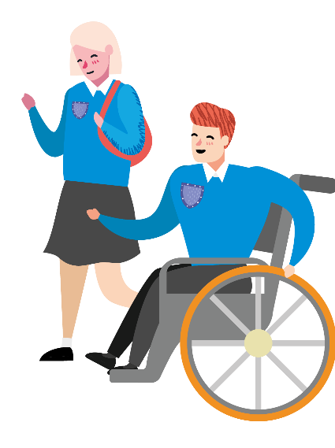
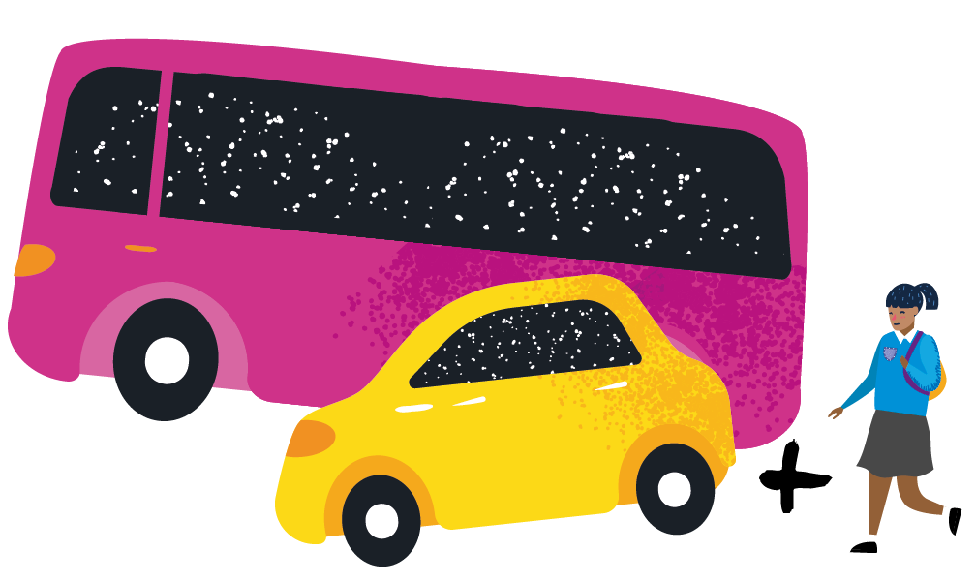

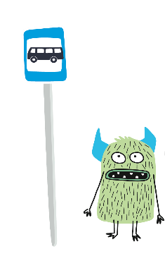
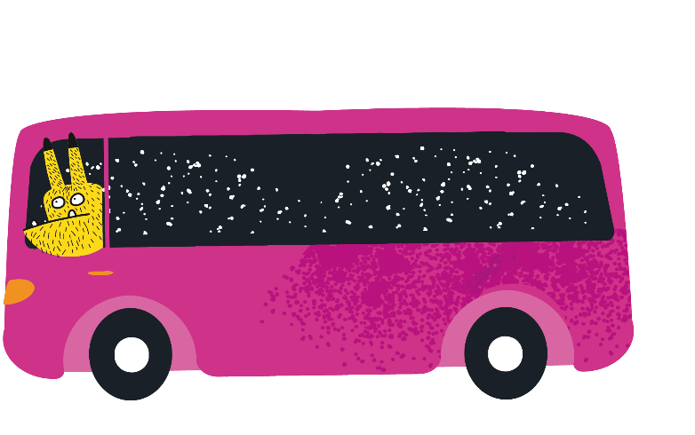
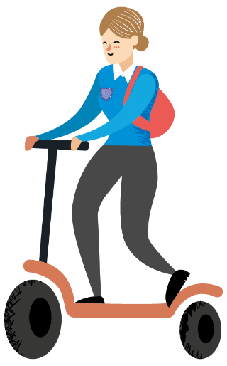
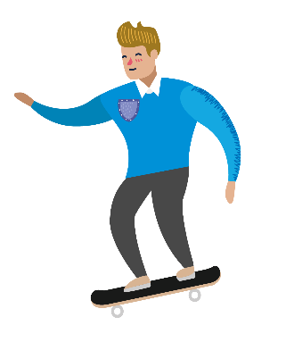
There are lots of ways to travel…
Notes:
There are lots of ways to travel. You might have walked or wheeled all the way to school. This includes those walking with mobility aids, such as wheelchairs or wheeled walkers. You might have cycled / scooted or come by skateboard. You may have come by public transport – using buses and trains to get you to the school gate. Or you may have travelled directly to school by car.
Alternatively, you may have walked part of the way – this combines public transport, car or taxi with a walk at the end to complete the journey. For example, getting out the car or off the bus a 10-minute walk from school, then walking / wheeling from there.

Slide 4

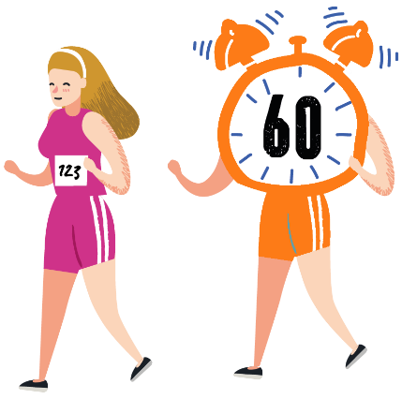



Reasons to move more
on your journey to school
Saves money
Helps you stay healthy
£££
Makes you feel happier
Doesn’t cause pollution
Gives you independence
Time with friends
Notes:
Some of you might need to use public transport or the car to travel to school but keeping active is really important. Chat to the person next to you and come up with some reasons. Then click through to reveal some of our reasons.

Slide 5






Next Steps Walking Challenge
HOW MANY
x
CHALLENGES
CAN YOU
COMPLETE?
Notes:
The Next Steps Walking Challenge is designed to help you benefit from moving more on your journey to and from school.
You’ll each receive a card with a set of challenges – some will help you prepare to walk more, others will encourage you to get out and move!
The aim is to complete as many of the challenges as you can, ticking them off as you go.

Slide 6

How to enter
NAME
I HAVE
COMPLETED
NEXT STEPS
CHALLENGES
_ _ _
TUTOR GROUP
TEAR HERE
Notes:
Those who take part are in with a chance to win a £10 Love To Shop Voucher. To enter, you’ll simply need to complete and return the bottom section of your challenge card, confirming your name, tutor group, and the number of challenges you have completed. There will be one winner per tutor group or class.

Slide 7



A chance to WIN!
Notes:
Your tutor will tell you when this challenge will start and finish. Some do this over one week, others extend it to 2 weeks.
At the end you will do a second hands up survey to see if there has been any change in the way you choose to travel to school.
You will now be handed a challenge card each. Good luck and enjoy the challenge!.

