Slide 2








WELCOME TO WOW
Hello, we’re Living Streets the UK charity for everyday walking
I hope you enjoy this presentation and I look forward to seeing how many of you are walking or travelling actively to school.
Notes:
Suggested script:
[Hello, my name is XXXX and I work for Living Streets, the UK charity for everyday walking.​
I’m here today to tell you about WOW – the walk to school challenge. It’s about earning badges if you walk or wheel, scoot or cycle or do Park and Stride to school. And these are the great badges you can collect.
​Put your hands up if you are up for a challenge!
Great, put them down.

Slide 3
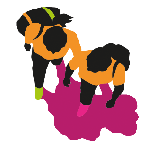

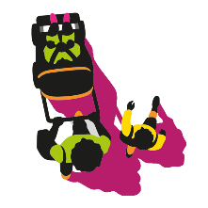
HOW DOES WOW WORK?
Enjoy the video!
Watch carefully, there will be questions afterwards
Notes:
Suggested script:
[You are now going to see a short video all about WOW, and what you need to do to take part.​
​
In this video you will hear the words Park and Stride. Park and Stride is a simple idea for families who live far away, and means they can still enjoy the benefits of walking to school. To Park and Stride, you just need to park the car 10 minutes away from the school gates and walk the remaining distance. There may be a place close to your school which can be set up as a formal Park and Stride location.​ We have resources on our website to help you do this. This is a great way to keep all school traffic away from the school gates, making it safer and cleaner for you all.
​
Enjoy the video. And listen carefully because there is a quiz coming up.]

Slide 4
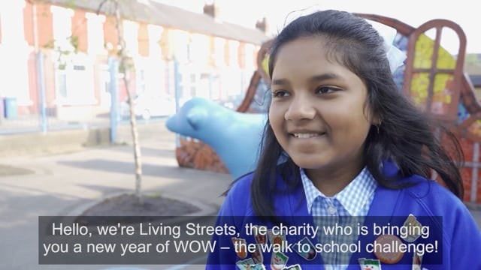
WATCH THE VIDEO

Slide 5
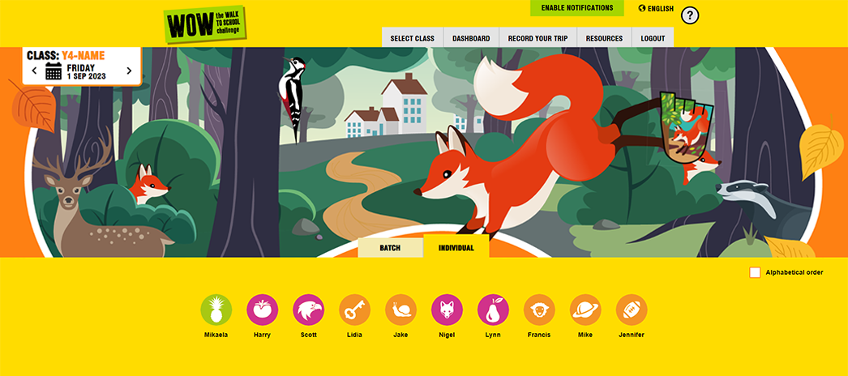
WOW TRAVEL TRACKER
Notes:
Suggested script:
NB If the school is set up – you could show them their account and they will see their names instead of slide 5-8
[As we’ve learned from the video, the Travel Tracker is the place you will go onto everyday to record your trips to school. Your teacher or a pupil WOW Ambassador will log into your Travel Tracker Account using your 3 word access code. They will then select your class and come to a page like this. You can access Travel Tracker and log journeys on the IWB, an ipad or a computer, whichever your teacher thinks is easiest for the class.
There are few things to point out.
Can you spot the badge on the right-hand side? This will tell you which badge to you trying to earn each month.
There is a calendar at the top left to show you are logging your journey for today. If you have missed a day, you can use this to go back and log the journeys you missed. We suggest you log your journeys daily as this makes it more accurate, and always check the calendar is set on the correct date before logging.
Below you can see lots of circles with white pictures inside. You will have a picture, and there is one for each of your classmates. Just above them there is an option to log your journeys individually or as a batch.
If you are doing it individually, simply select your picture. This will take you to the next page. Click on to see the next slide]

Slide 6
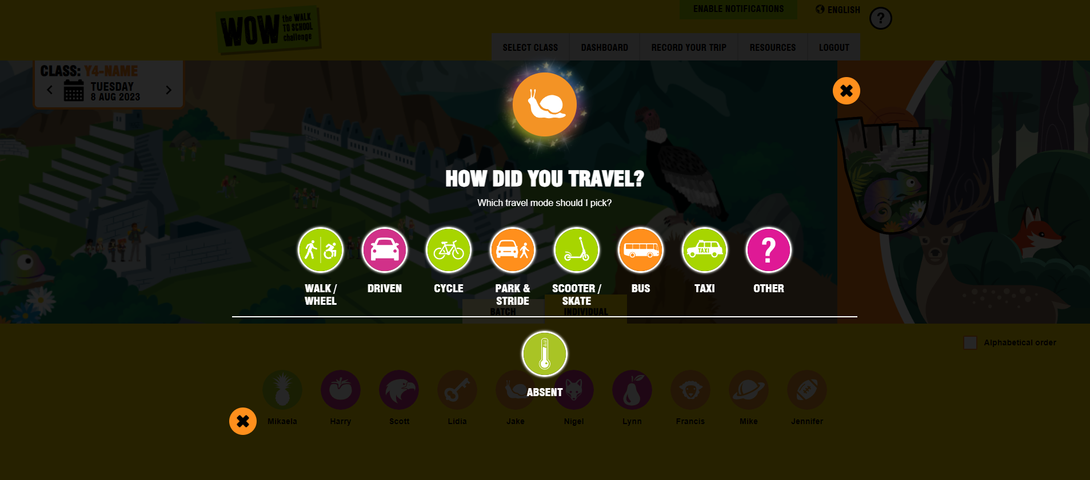
WOW TRAVEL TRACKER
Notes:
Suggested script:
Once you select your icon you will be brought to this page, where you record how you came to school. Select the one that best suits you. If you selected the wrong picture by mistake, just click on the cross to go back.
If you are recording someone who is not at school today, select absent. This is really important as it will give them a fair chance of earning a badge like everyone else. The next slide explains the batch recording option instead of individual recording.]

Slide 7
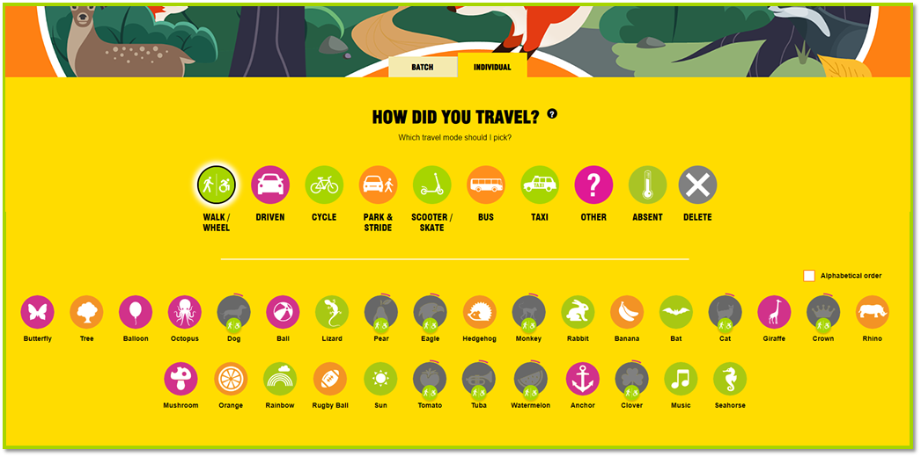
WOW TRAVEL TRACKER
BATCH ENTRY
Notes:
NOTE: Opportunity to show the batch entry feature here and explain it as an alternative to individual entry for speed allowing one person to take control for the whole class.
Suggested script:
[This option allows the teacher or a pupil to record journeys for the whole class. Select the type of transport, for example ‘who walked/wheeled the whole journey to school?’ all those with their hands up can be selected. Go through each type of transport until everyone’s journey has been recorded. The next slide shows how you can see which classes and schools are recording and making the most active journeys.

Slide 8
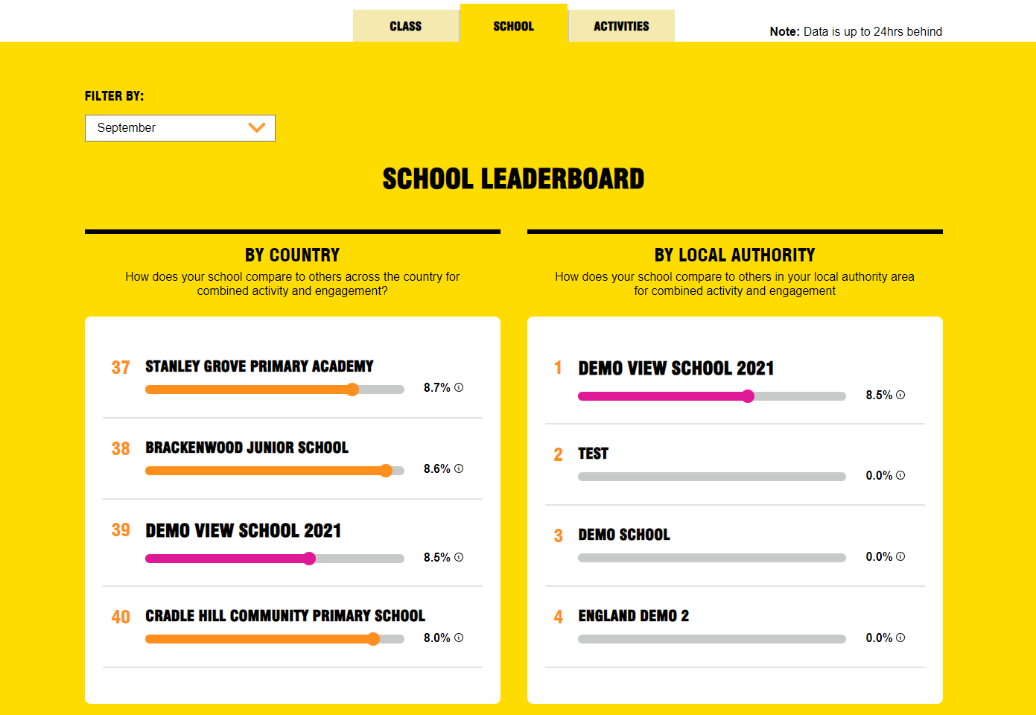
WOW TRAVEL TRACKER
LEADERBOARD
Notes:
Suggested script:
[This is a great way to get some healthy competition going; between classes, but also between schools in the local area or nationally! You can access the leaderboard page by clicking on the Dashboard tab back on the main page. Here you can select the ‘class tab’ to see the class of the month or select the ‘school tab’ to see your school’s position on the local or national leaderboard. We have a selection of editable certificates that you teacher or WOW Ambassadors can award to the top classes or to the whole school during assemblies! Those who love maths, can work out how far ahead they are or what they need to do to pickup the pace. You teacher can even check how well you are doing compared to other schools.]

Slide 9

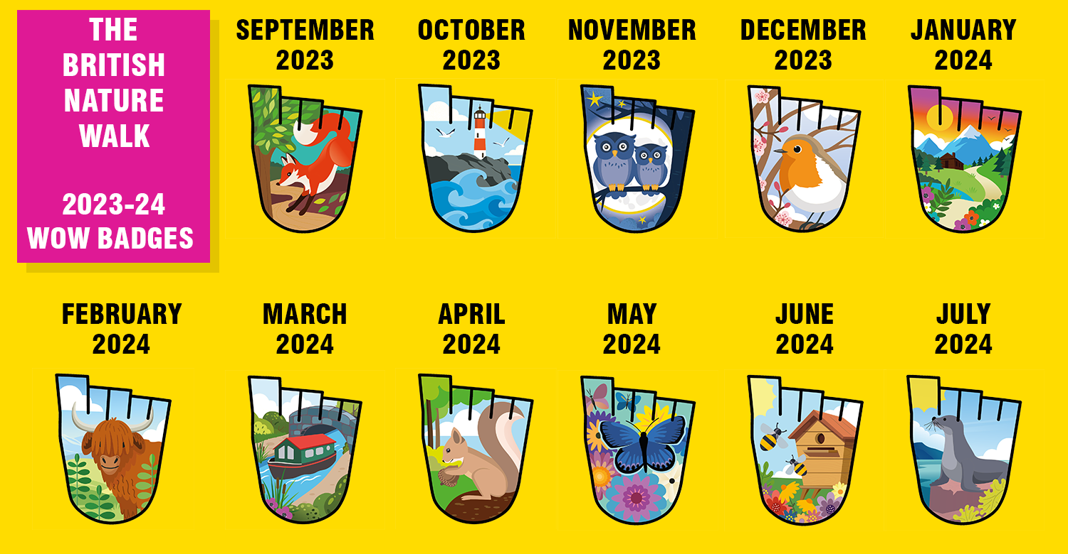
WHAT IS YOUR FAVOURITE?
Notes:
Now the moment you’ve been waiting for……the badges! This year’s theme is The British Nature Walk, so all of the badges are about nature in the U.K and you will see the badges have mammals, birds, insects and landscapes. All of the badges have been designed by children who took part in the WOW challenge last year. Now, have a look now and decide which is your favourite. In a moment, your teacher can call out each badge by month and you to put your hand up when its your favourite. Remember to put your hand up just once, and put it straight up and straight down so you don’t bash the person next to you!

Slide 10
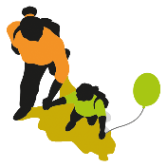
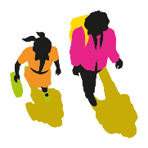
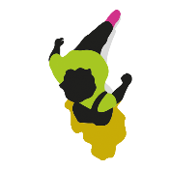
QUIZ TIME!
1. WHAT IS PARK AND STRIDE?
2. WHAT DOES IT MEAN TO TRAVEL "ACTIVELY" TO SCHOOL?
Park and Stride means parking the car
10 minutes away from school and walking the rest of the journey. This way you can
still earn a badge!
It means you are using the power of your body
to travel somewhere. Examples of 'active' travel are
walking (using a wheelchair or mobility aid count
too!), cycling, skating and scooting.
3. WHAT ARE THE BENEFITS OF WALKING TO SCHOOL?
Walking is a form of exercise, and it keeps us healthy
It’s great for our minds and bodies
Opportunity to spend time with our families
By walking we help reduce pollution
Great for the planet

Slide 11
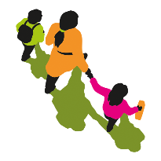
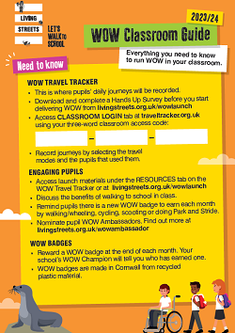
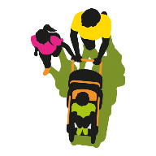
FINAL CHECK
Make sure you have your classroom guide with your three-word access code to access the WOW Travel Tracker.
Appoint your WOW Ambassadors to encourage everyone to log their trips and award badges.
Log on at traveltracker.org.uk and start recording your activity!
Notes:
Suggested script:
[All that remains to be said it to try to remember all those great reasons you came up with for walking during the quiz. I can guarantee the more you walk, scoot or cycle to school - it will brighten up your day and those around you.
​
​ You are now ready to start your challenge.
Good luck and I hope you enjoy being active and earning lots of badges.]

Slide 12

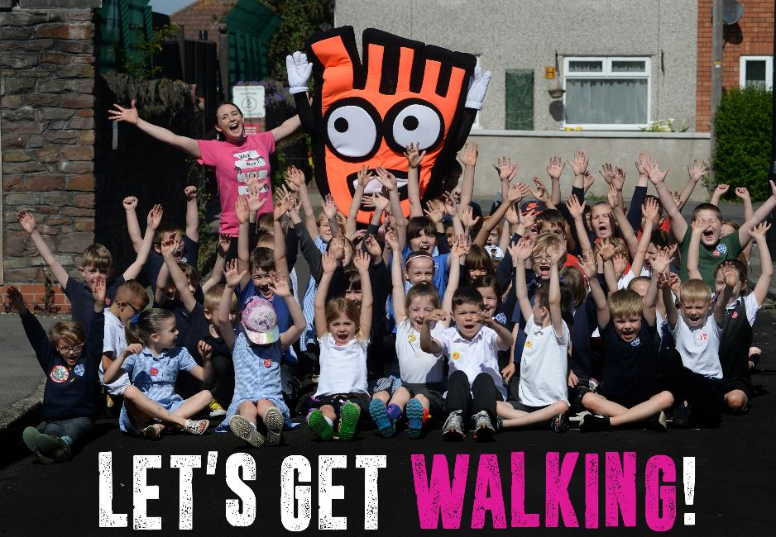


YOU CAN FIND MORE USEFUL RESOURCES, VIDEO AND FAQS AT: www.livingstreets.org.uk/wowlaunch
LOG ON TO THE WOW TRAVEL TRACKER
www.traveltracker.org.uk

